Slide 1
Welcome to Azure Defender + Azure Sentinel Better Together! Day 1

Slide 2
A look into Day 1
Kick-Off | 8:00-8:05 | Welcome | Main Call
 | 8:05-8:30 | Security Center + Azure Defender
 | 8:30-8:45 | Demo Walkthrough
High-Level | 8:45-9:00 | Break
 | 9:00-10:00 | Azure Security Center, Defender, Arc, Lighthouse
 | 10:00-10:15 | Break
 | 10:15-11:15 | Azure Defender Solutions
 | 11:15-12:00 | Activity: Azure Defender Solutions | Table Group Call
Getting Technical | 12:00-1:00 | Long Break | Main Call
 | 1:00-1:30 | Azure Sentinel
 | 1:30-2:00 | Activity: Azure Sentinel | Table Group Call
 | 2:00-4:00 | Build Hands-on: Azure Defender, Azure Sentinel | Table Group Call
 | 4:00-4:15 | Closing | Main Call
Today we will be learning and collaborating across three spaces:
Main call (this meeting)
Table Group channel within the event Team
CloudLabs Learner Portal & Lab environment
Presentation/
Whole Group
Lab
Activity/ Discussion/ Group Work
Announcements

Slide 3
Pre-requisites
AZ-500 - Microsoft Azure Security Technologies
https://query.prod.cms.rt.microsoft.com/cms/api/am/binary/RE3VC70
SC-200 - Microsoft Security Operations Analyst
https://query.prod.cms.rt.microsoft.com/cms/api/am/binary/RE4Myp3

Slide 4
Security Center + Azure Defender + Azure Sentinel

Slide 5
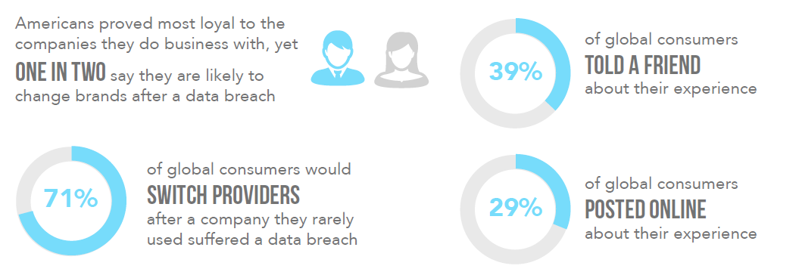
Why are we here?
Of all the major costs and risks associated with managing a security incident, the potential hit to brand and reputation and loss of customer trust could be the most damaging.

Slide 6
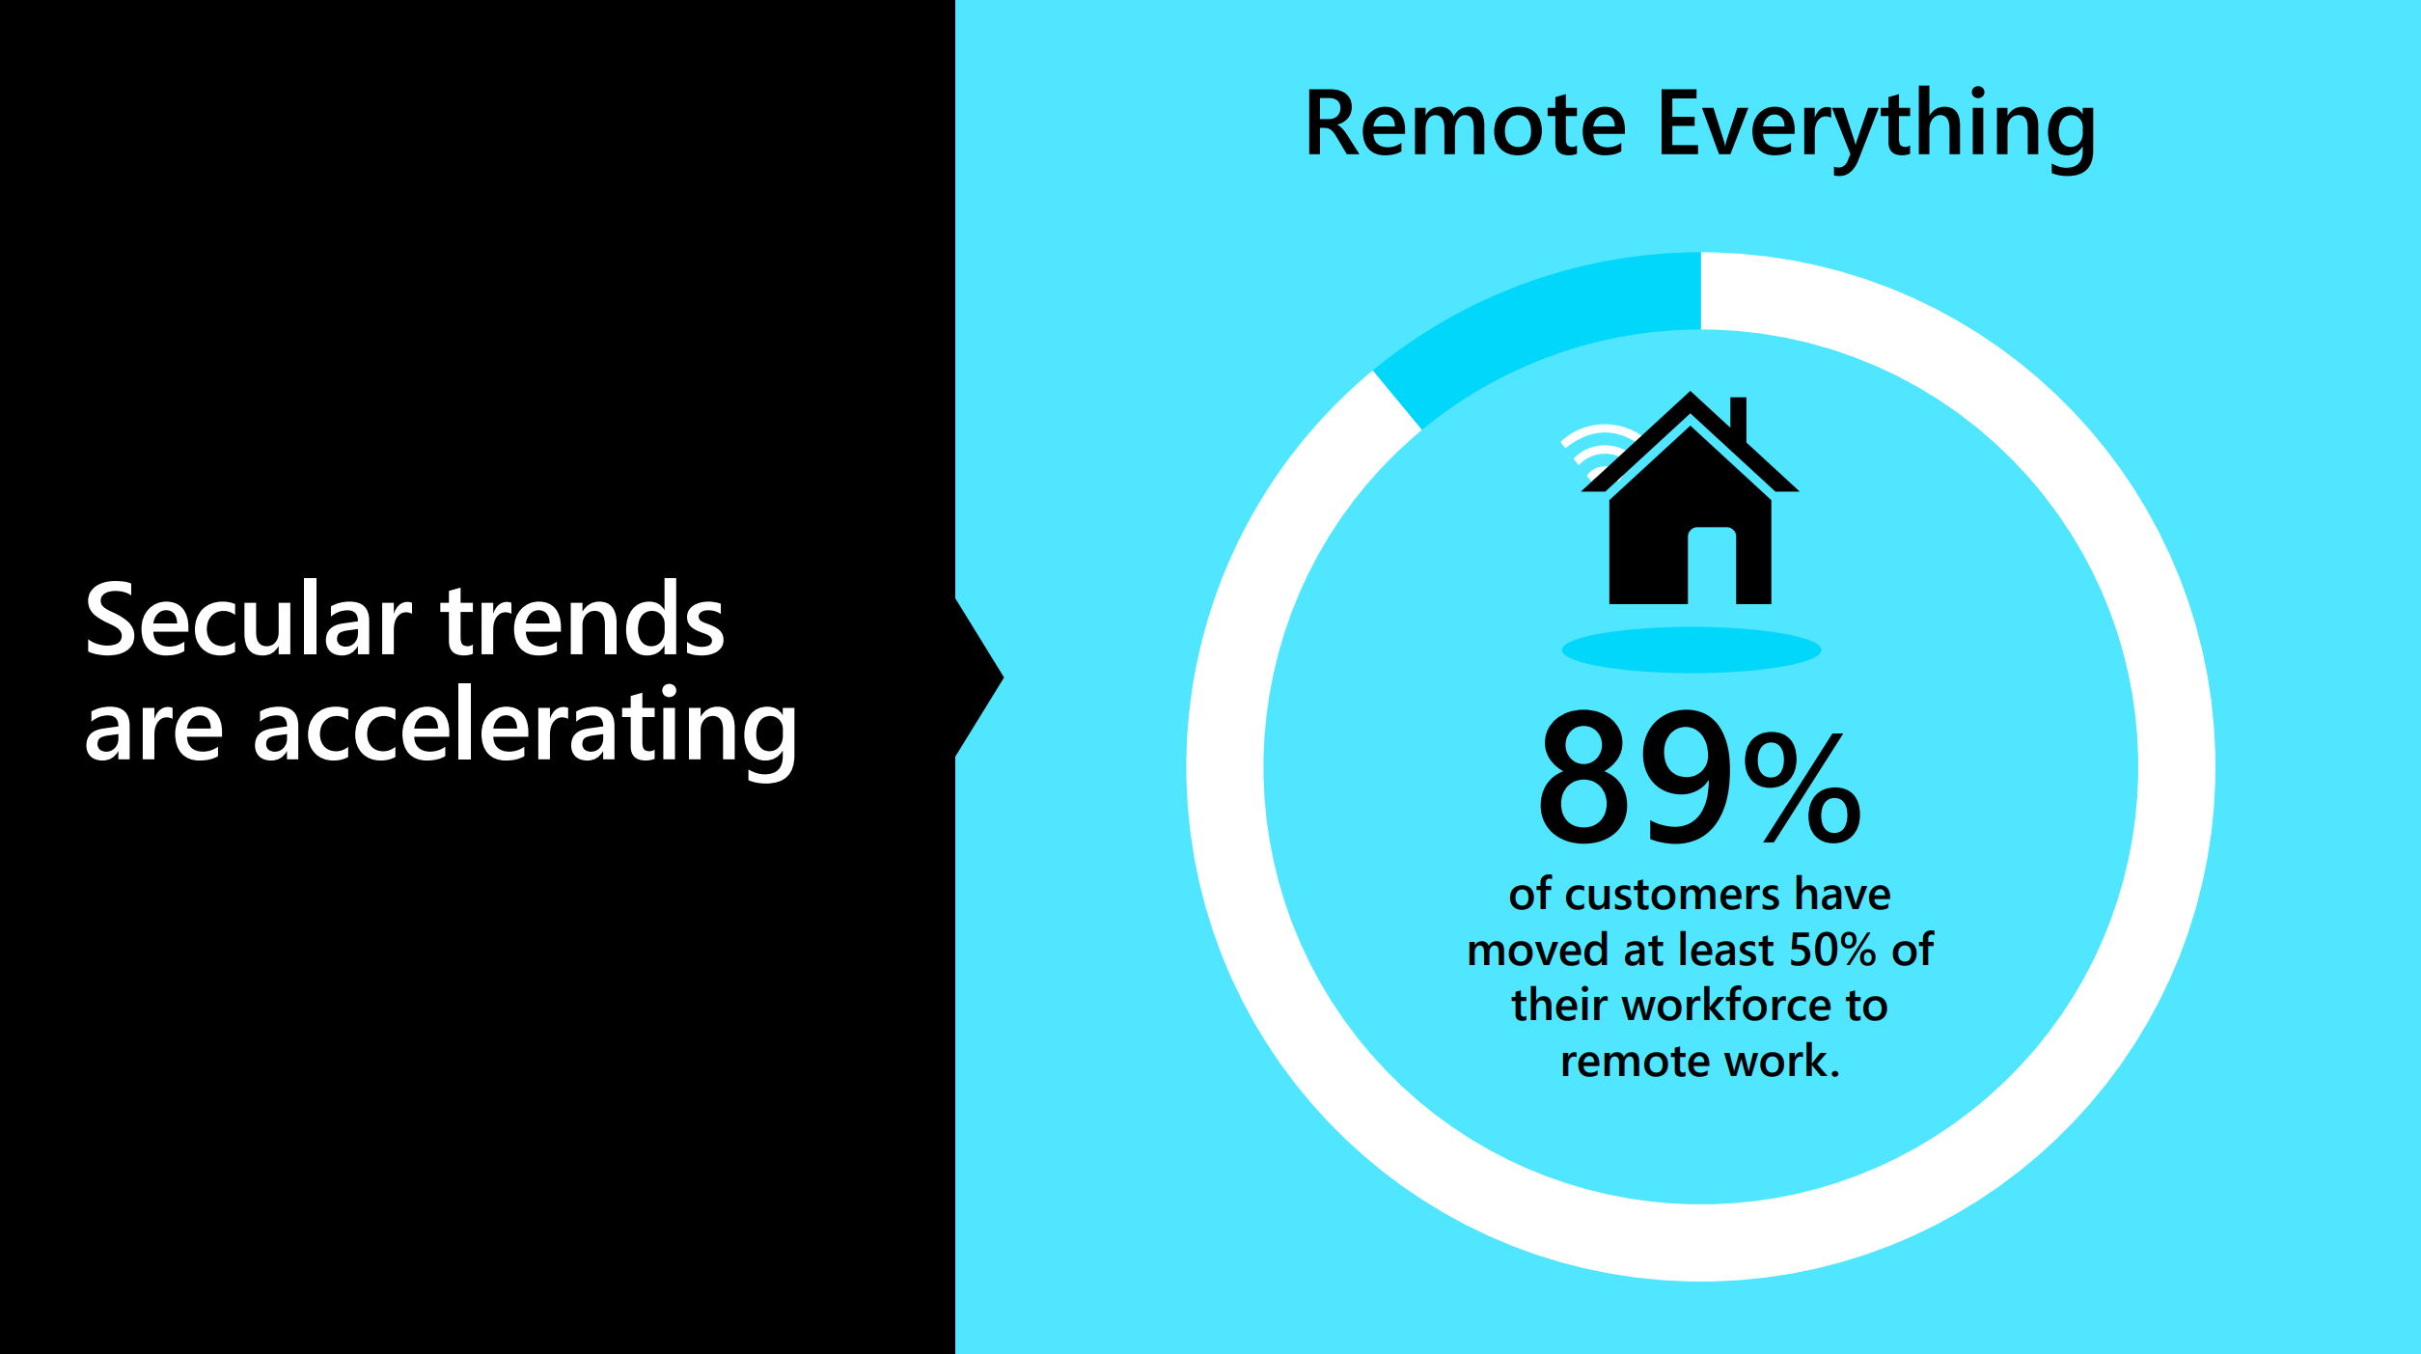

Slide 7
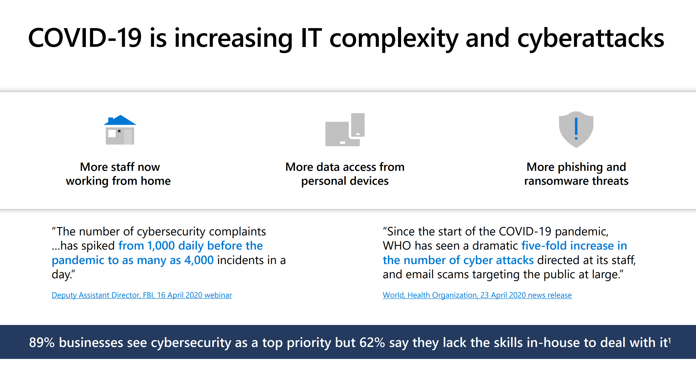

Slide 8
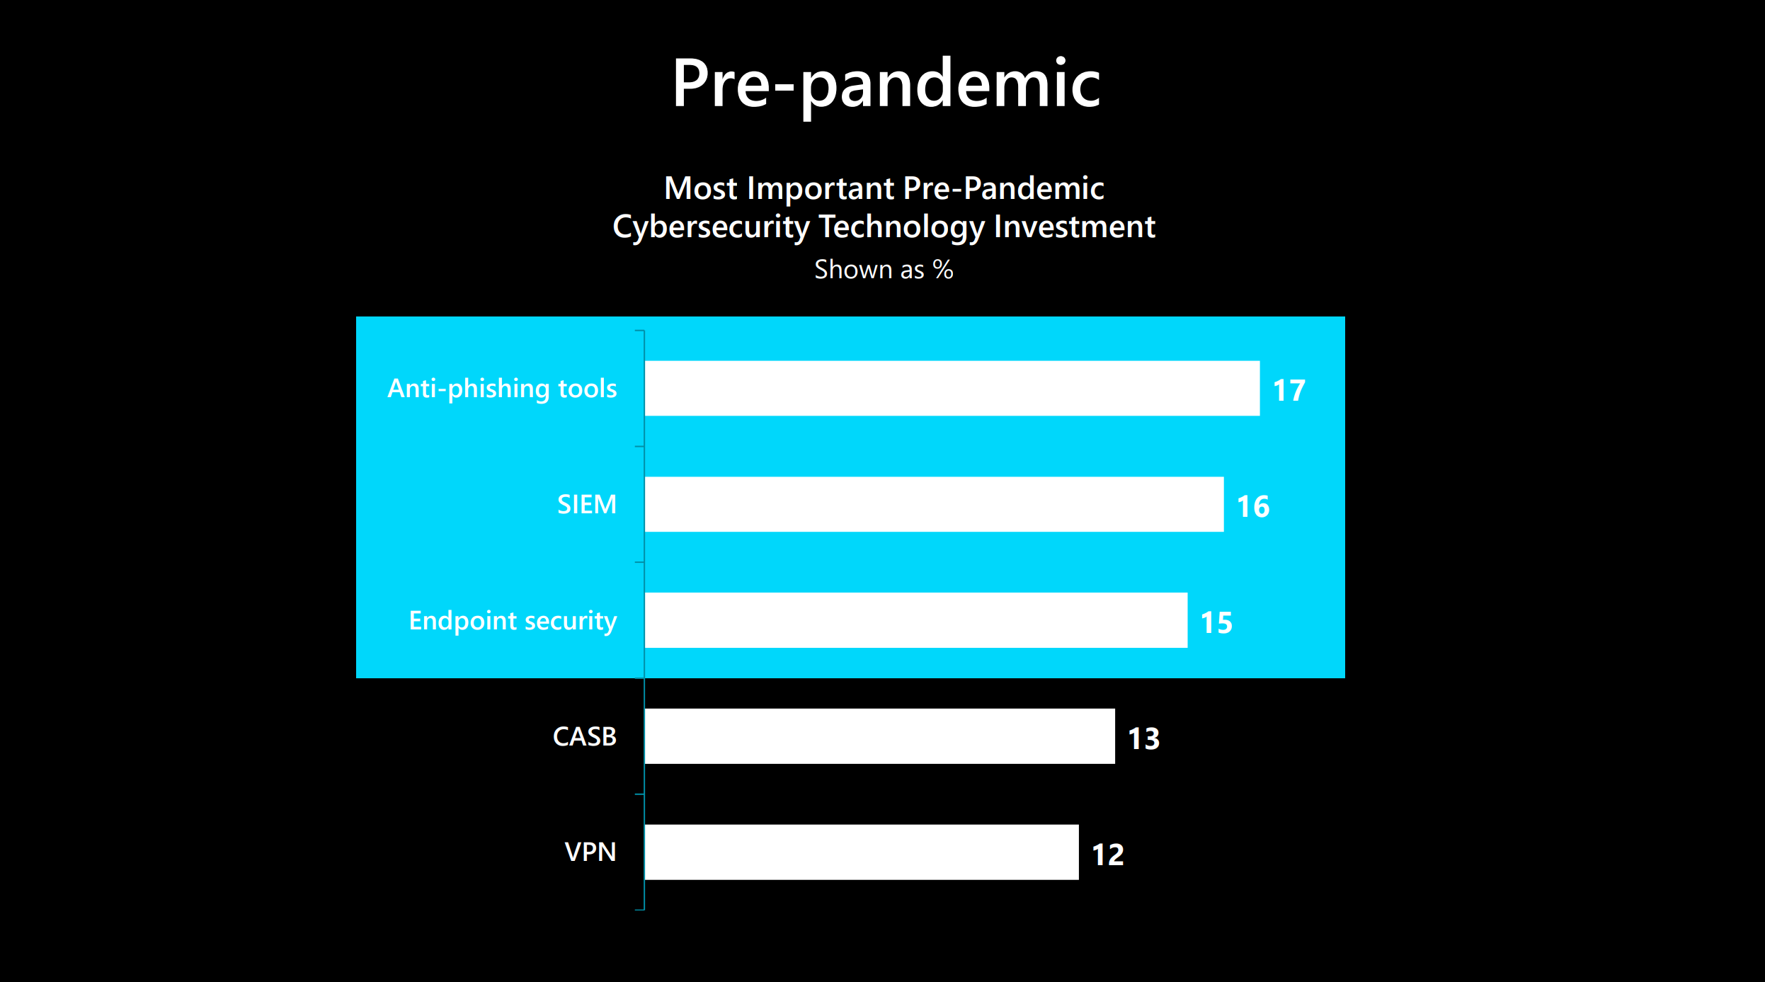

Slide 9
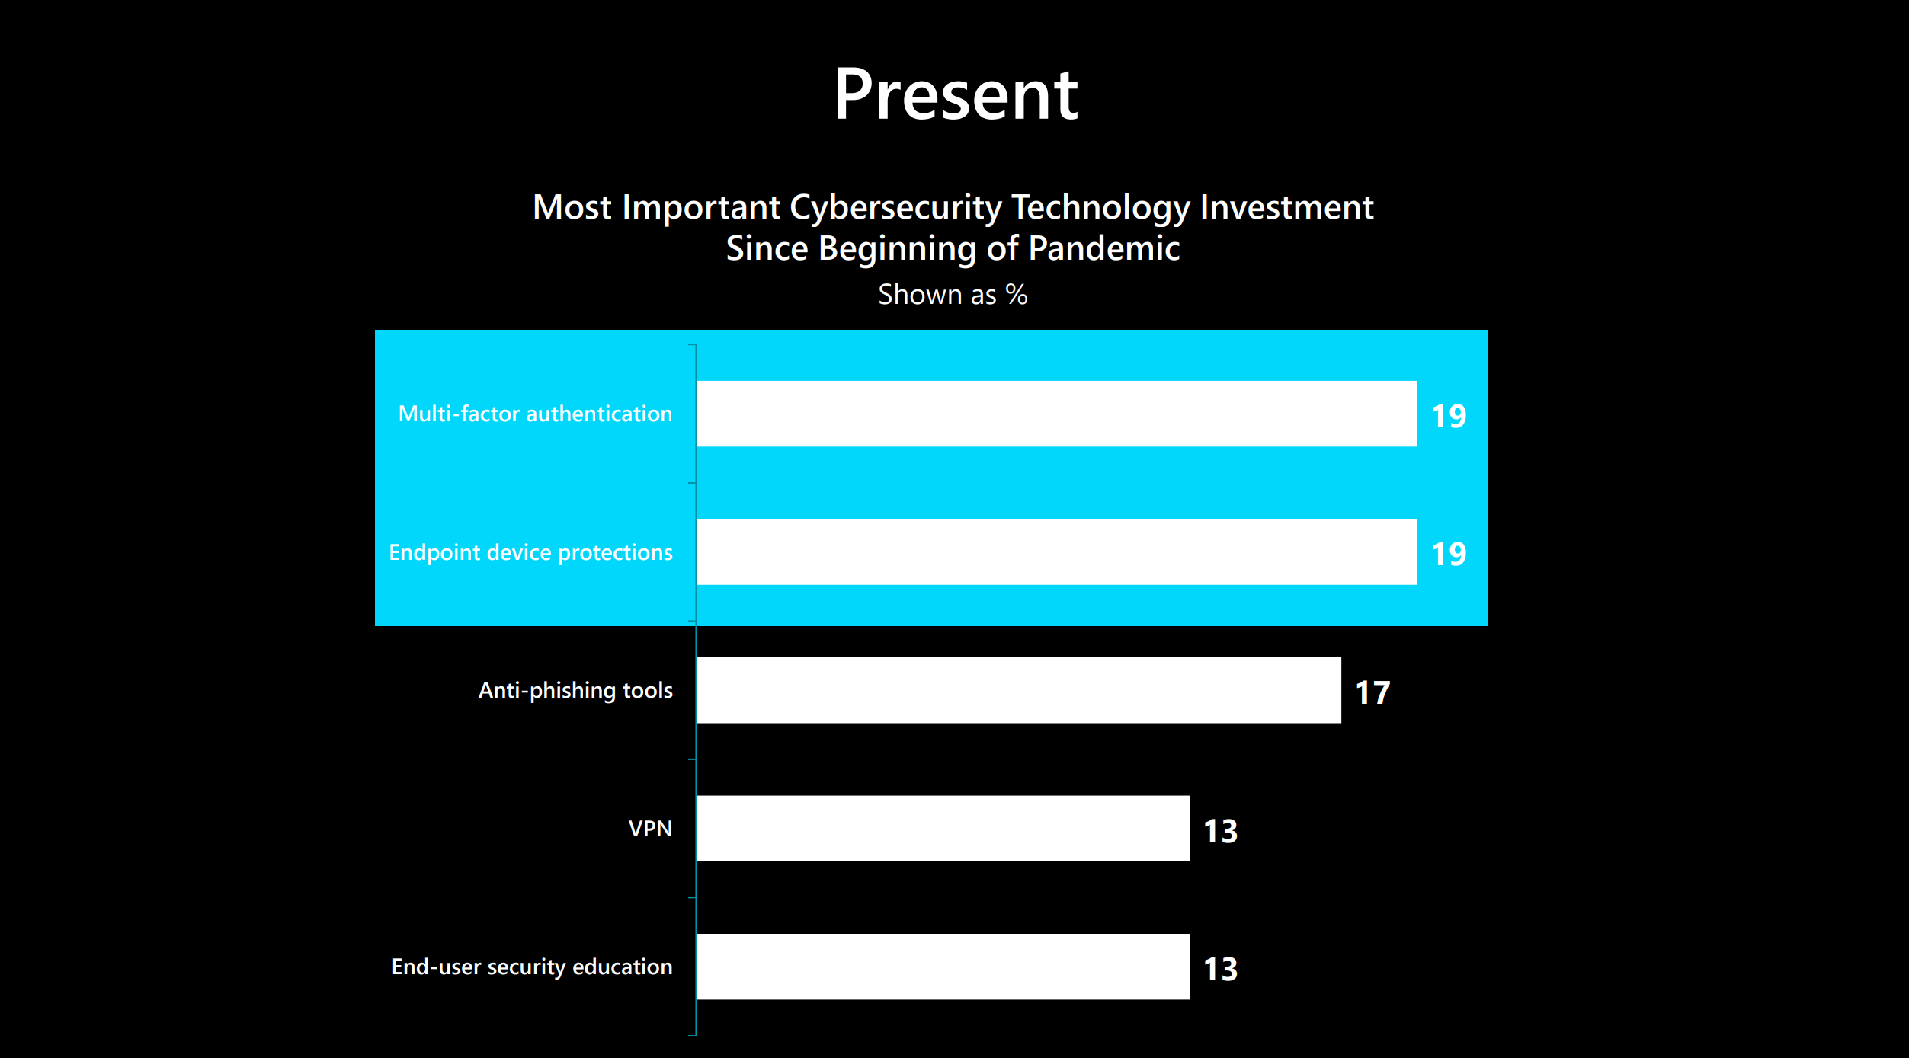

Slide 10
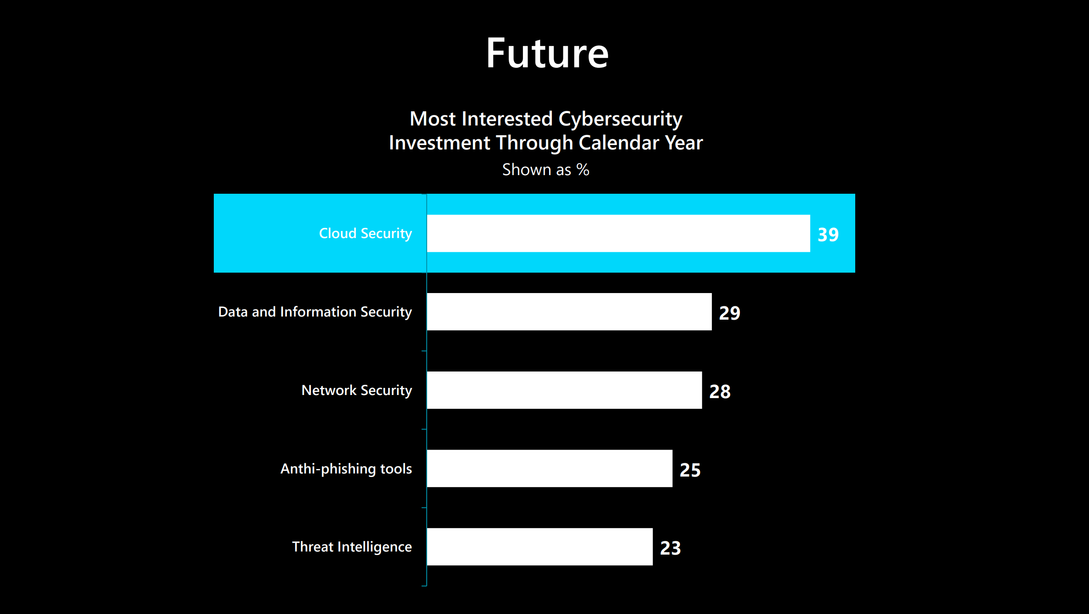

Slide 11
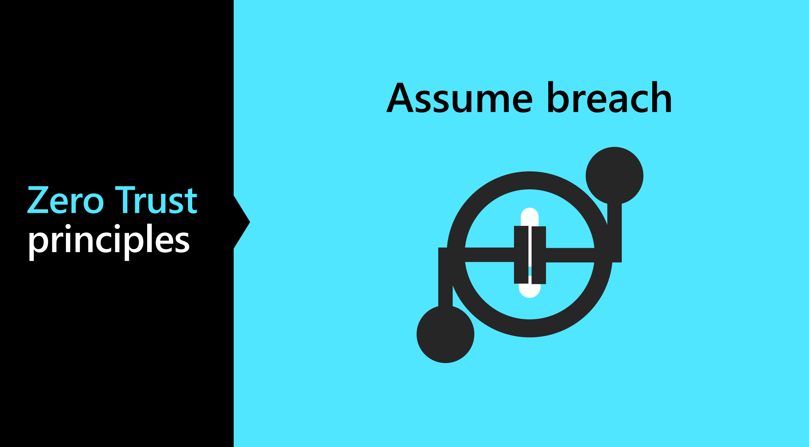

Slide 12
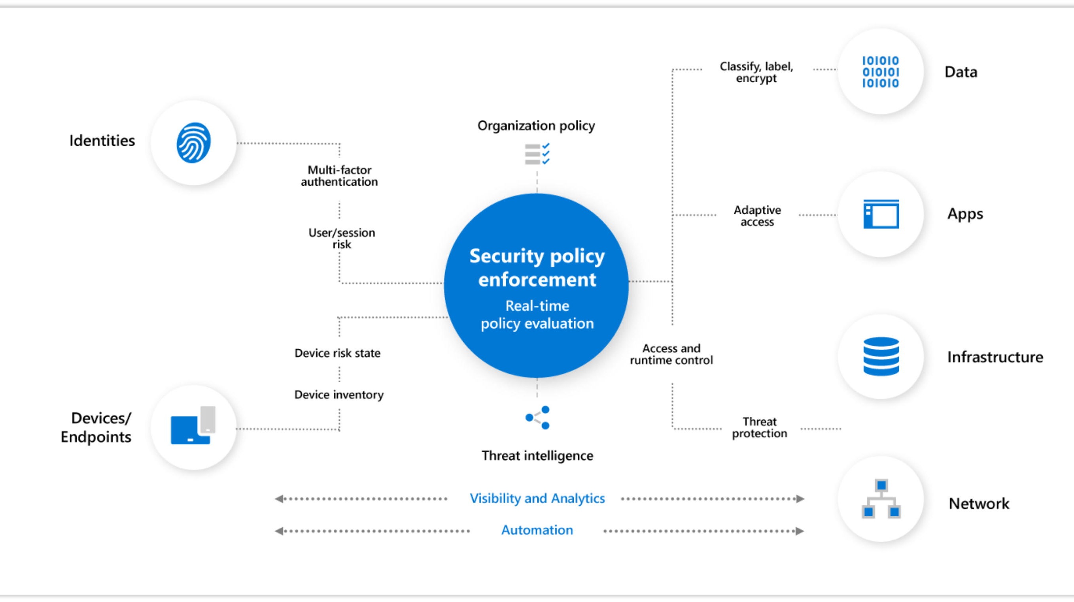

Slide 13
Azure Defender + Azure Sentinel : Better Together
The next two days will focus on how Azure Defender and Azure Sentinel through working together using other underlying products protect a customer’s infrastructure and business from threats.
Day 1:
A look at Azure Security Center, Azure Defender, Azure Arc, Azure Lighthouse, Azure Policy and IoT Security with activities and labs
A look at Azure Sentinel with activities and labs, specifically how to migrate from other SIEM systems.
Day 2:
How Azure Defender and Azure Sentinel utilize Log Analytics + Azure Automation to implement a highly efficient Security Operations Center with activities and labs.
Highlight: Respond to a real attack.

Slide 14
Thank You slide
Break (15 mins)

Slide 15
Azure Security Center

Slide 16
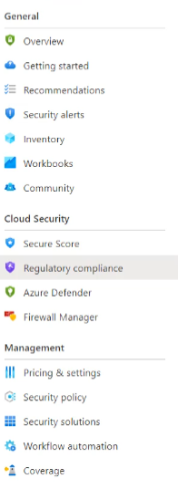
Azure Security Center
Azure portal for managing best practice security recommendations and alerts mainly focused on the Azure “control” plane, although a few protections cover data plane components.
Major Components include:
Secure Score
Regulatory compliance
Azure Defender
Firewall Manager
Notes:
TODO

Slide 17
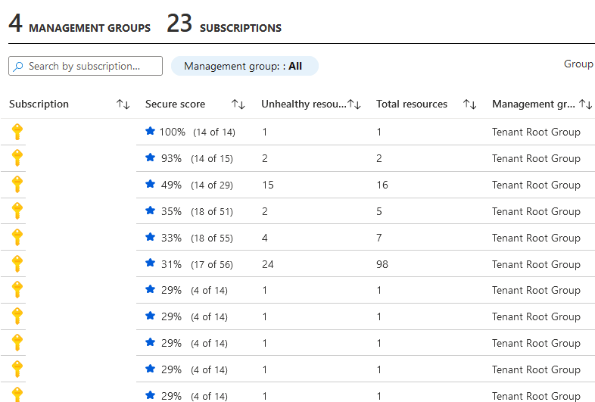
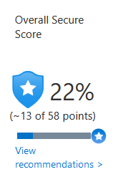
Secure Score
Your Secure Score is a measure of the security posture of your subscription: the higher the score, the lower the identified risk level.
Notes:
TODO

Slide 18
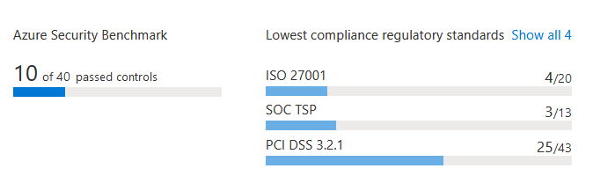
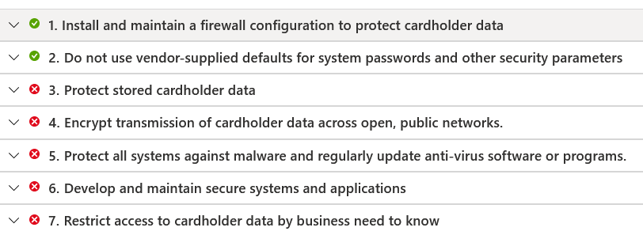






Regulatory Compliance
Track your Azure security posture against common compliance standards (ISO 27001, PCI DSS 3.2.1 and SOC).
Notes:
TODO

Slide 19
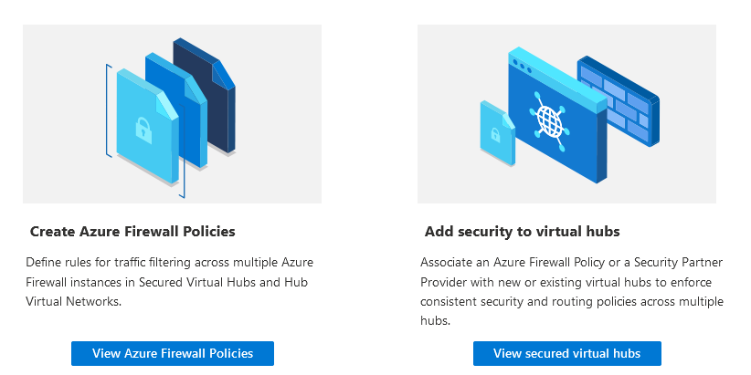
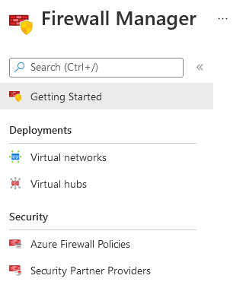
Firewall Manager
A central security policy and route management service for cloud-based security perimeters
Single pane of glass for managing your Firewall Policies and how they map to your virtual networks.
Notes:
TODO

Slide 20
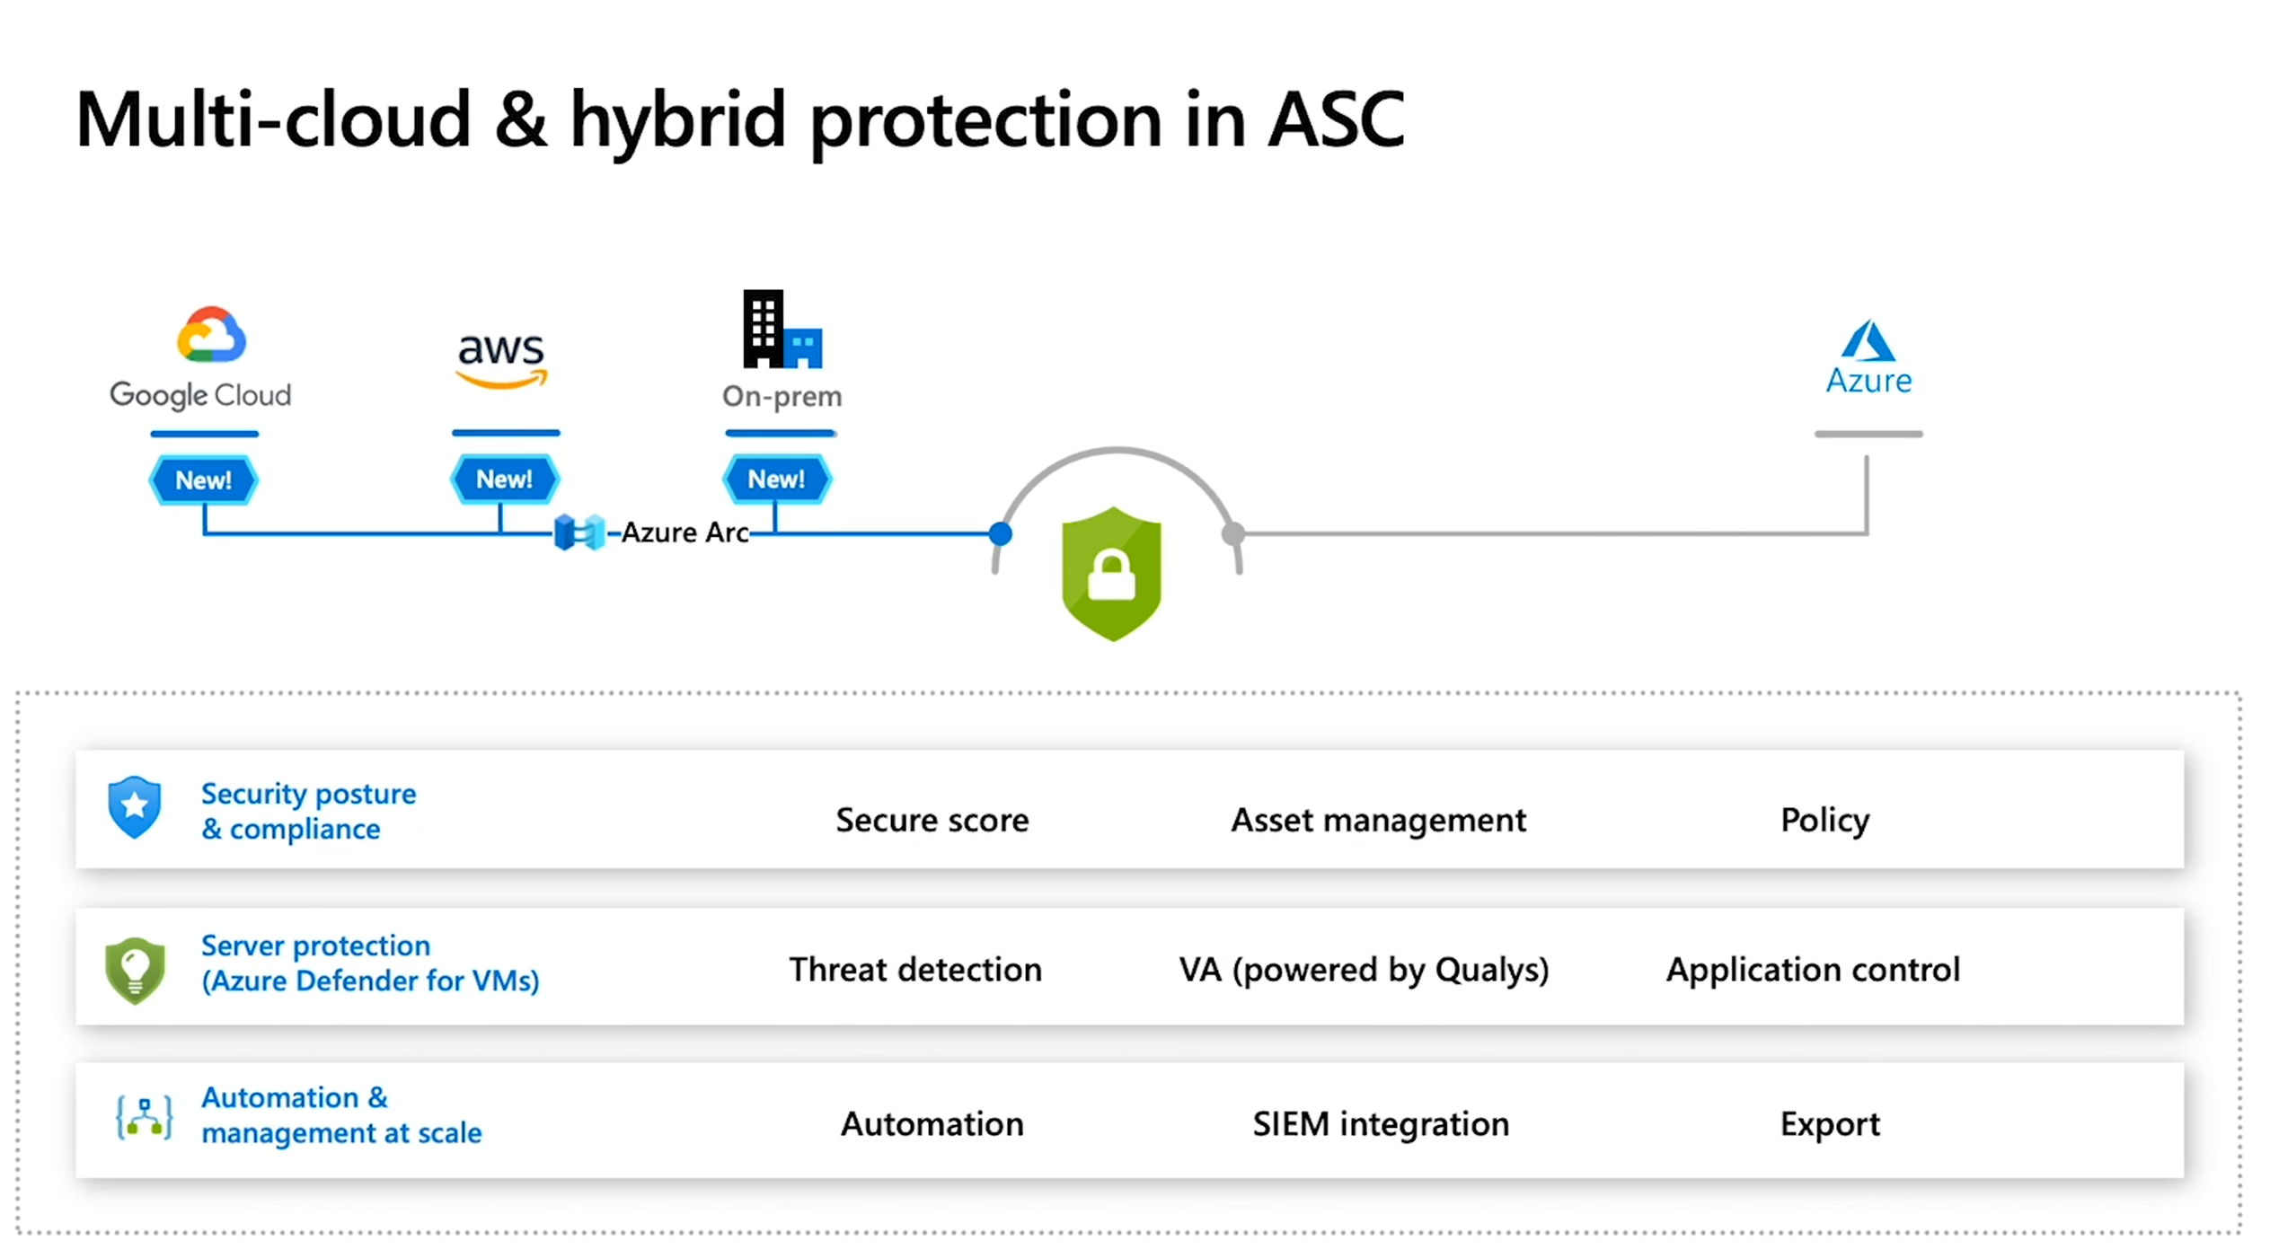

Slide 21
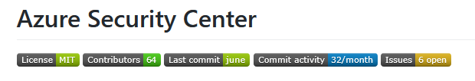
Community Repository
Open source community facilitating collaboration among customers and partners through GitHub.
Available on GitHub as a valuable resource fore the community
Security recommendations that are in private preview
Programmatic remediation tools for security recommendations
PowerShell scripts for programmatic management
Azure Policy custom definitions for at-scale management of Azure Security Center
Logic App templates that work with Security Center's Logic App connectors (to automate response to Security alerts and recommendations)
Logic App templates that help you run regular tasks or reports within the scope of Azure Security Center
Custom workbooks to visualize Azure Security Center data
Notes:
https://github.com/Azure/Azure-Security-Center

Slide 22
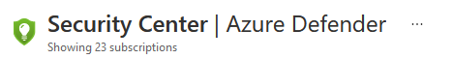
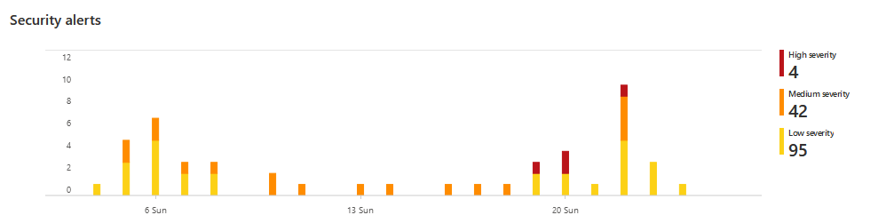
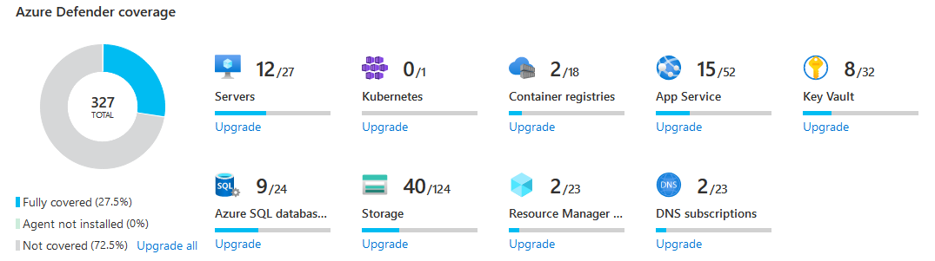
But let’s talk about…

Slide 23
Azure Defender

Slide 24
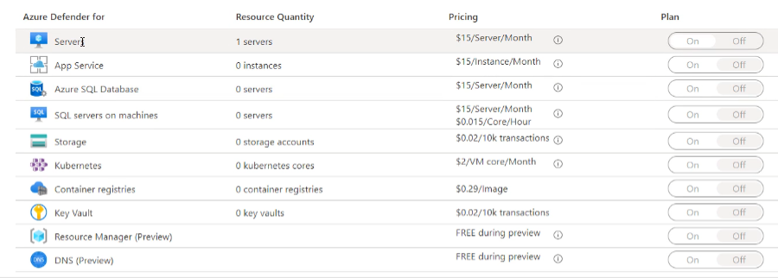
Azure Defender
Paid option
VM Vulnerability Assessment
Just in Time VM Access
Adaptive Application Control
Container Image Scanning
Adaptive Network Hardening
SQL Vulnerability Assessment
File Integrity Monitoring
Network Mapping
IoT Security

Slide 25
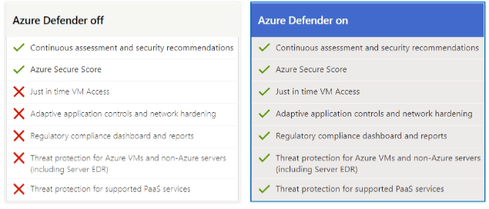
Azure Defender

Slide 26
CSPM Philosophy
Cloud Security Posture Management
Considering Zero Trust Security Model
Considering App Risk Scores
Considering TVM (Threat & Vulnerability Management) for totality of the entire attack Service
Considering the Threat Model Tool

Slide 27
Azure Arc

Slide 28
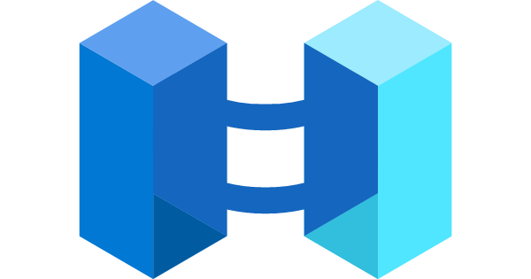
Azure Arc
Azure Arc simplifies governance and management by delivering a consistent multi-cloud and on-premises management platform.
Azure Arc enables you to:
Manage your entire environment, with a single pane of glass, by projecting your existing non-Azure, on-premises, or other-cloud resources into Azure Resource Manager.
Manage virtual machines, Kubernetes clusters, and databases as if they are running in Azure.
Use familiar Azure services and management capabilities, regardless of where they live.
Continue using traditional ITOps, while introducing DevOps practices to support new cloud native patterns in your environment.
Configure Custom Locations as an abstraction layer on top of Azure Arc enabled Kubernetes cluster, cluster connect, and cluster extensions.

Slide 29
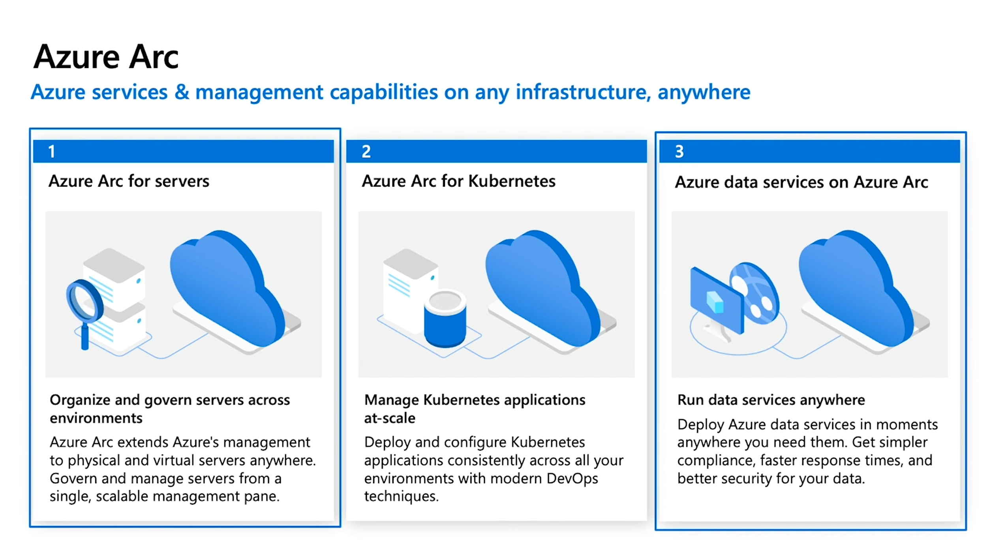

Slide 30
Supported Service
Today, Azure Arc allows you to manage the following resource types hosted outside of Azure:
Servers - both physical and virtual machines running Windows or Linux.
Kubernetes clusters - supporting multiple Kubernetes distributions.
Azure data services - Azure SQL Managed Instance and PostgreSQL Hyperscale services.
SQL Server - enroll instances from any location.

Slide 31
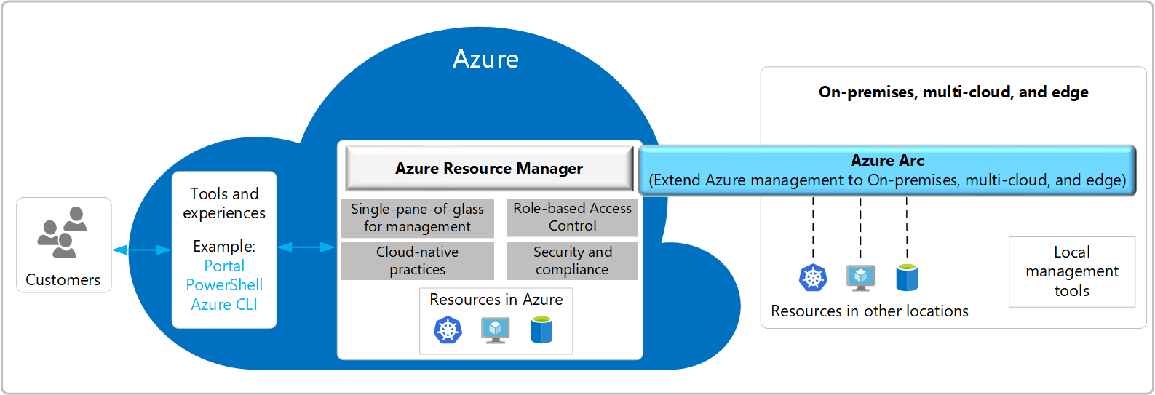
Azure Arc Architecture

Slide 32
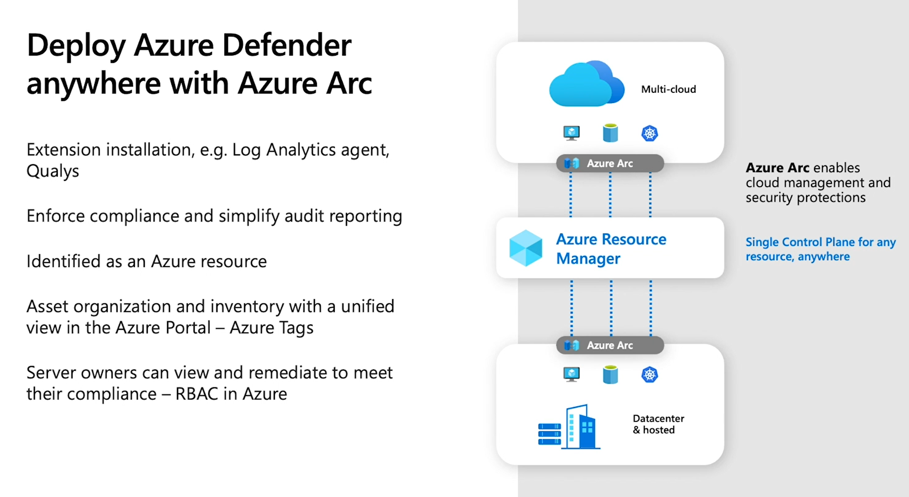

Slide 33
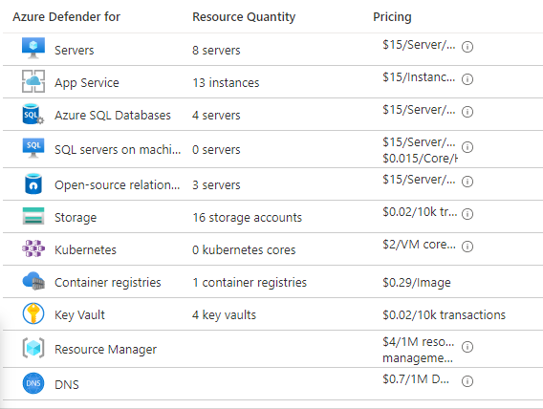
Azure Arc + Azure Security Center
Any Azure service that is used on Arc enabled servers, for example Azure Security Center or Azure Monitor, will be charged as per the pricing for that service.

Slide 34
Azure Lighthouse

Slide 35
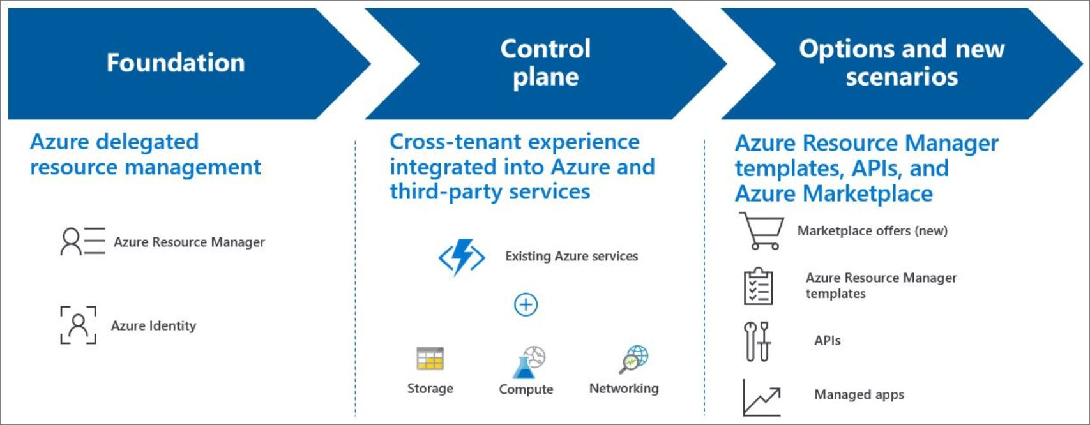
Azure Lighthouse
Azure Lighthouse enables cross- and multi-tenant management, allowing for higher automation, scalability, and enhanced governance across resources and tenants.

Slide 36
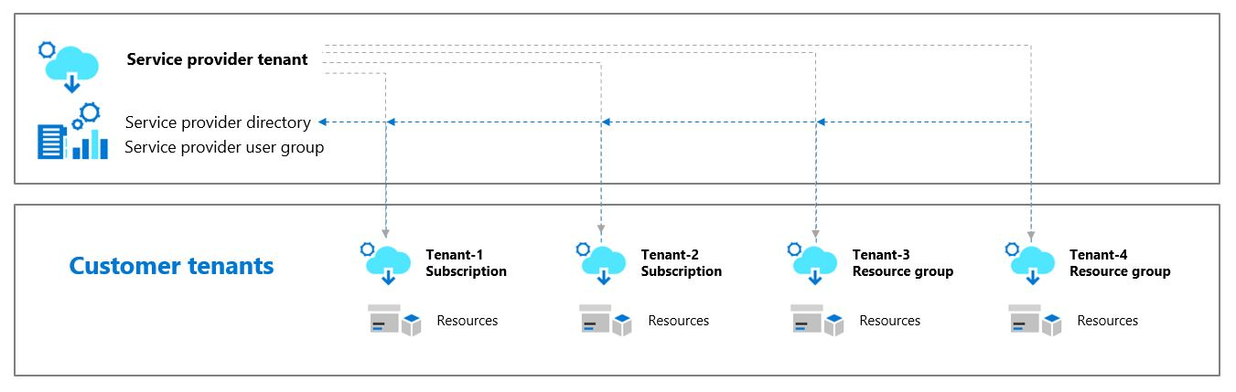
Azure Lighthouse Architecture
Azure Lighthouse helps service providers simplify customer engagement and onboarding experiences, while managing delegated resources at scale with agility and precision.
Authorized users, groups, and service principals can work directly in the context of a customer subscription without having an account in that customer's Azure Active Directory (Azure AD) tenant or being a co-owner of the customer's tenant.

Slide 37
Thank You slide
Break (15 mins)

Slide 38
Welcome Back!
Kick-Off | 8:00-8:05 | Welcome | Main Call
 | 8:05-8:30 | Security Center + Azure Defender
 | 8:30-8:45 | Demo Walkthrough
High-Level | 8:45-9:00 | Break
 | 9:00-10:00 | Azure Security Center, Defender, Arc, Lighthouse
 | 10:00-10:15 | Break
 | 10:15-11:15 | Azure Defender Solutions
 | 11:15-12:00 | Activity: Azure Defender Solutions | Table Group Call
Getting Technical | 12:00-1:00 | Long Break | Main Call
 | 1:00-1:30 | Azure Sentinel
 | 1:30-2:00 | Activity: Azure Sentinel | Table Group Call
 | 2:00-4:00 | Build Hands-on: Azure Defender, Azure Sentinel | Table Group Call
 | 4:00-4:15 | Closing | Main Call
Presentation/
Whole Group
Lab
Activity/ Discussion/ Group Work
Announcements

Slide 39
Azure Defender Solutions

Slide 40

Agenda
1 Azure Defender Solutions
VM+SQL Vulnerability
File Integrity
Container Image Scanning
Adaptive Application Control
Adaptive Network Hardening
JIT VM Access
Network Map
IoT Security

Slide 41
VM + SQL Vulnerability Assessments

Slide 42
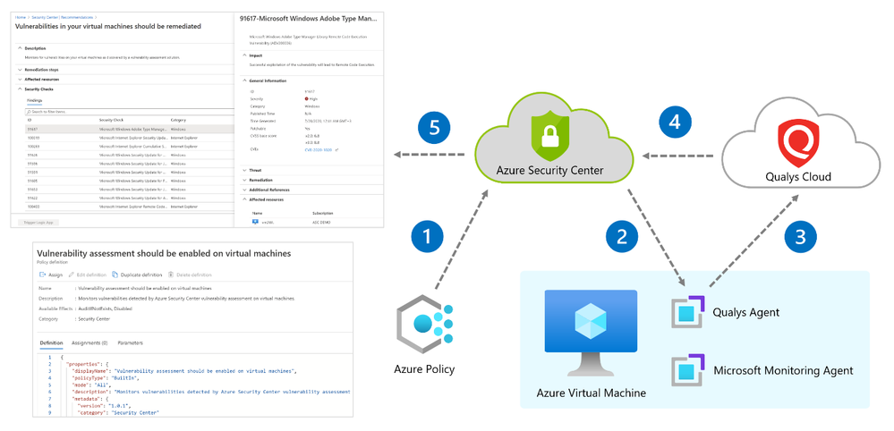
Azure Defender – VM Vulnerability Assessment
Azure Defender includes vulnerability scanning for your machines at no extra cost.
Security Center's integrated vulnerability assessment solution works seamlessly with Azure Arc. When you've deployed Azure Arc, your machines will appear in Security Center and no Log Analytics agent is required.

Slide 43
Qualys Scanner
The vulnerability scanner included with Azure Security Center is powered by Qualys. Qualys' scanner is one of the leading tools for real-time identification of vulnerabilities.
You don't need a Qualys license or even a Qualys account - everything's handled seamlessly inside Security Center.
The Azure Security Center vulnerability assessment extension (powered by Qualys), like other extensions, runs on top of the Azure Virtual Machine agent. Runs as Local Host on Windows, and Root on Linux.
During setup, Security Center checks to ensure that the machine can communicate with the following two Qualys data centers (via port 443 - the default for HTTPS):
64.39.104.113 - Qualys' US data center
154.59.121.74 - Qualys' European data center
Notes:
Qualys Terms:
https://ascva.blob.core.windows.net/vadocs/ASC-Qualys-%20EULA.pdf

Slide 44
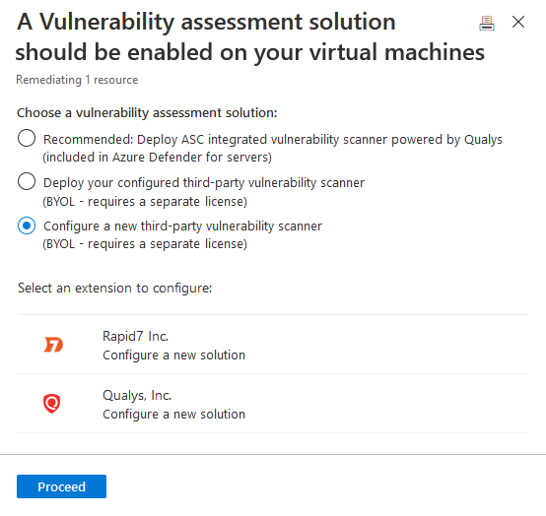
Third-party vulnerability scanners
The BYOL options refer to supported third-party vulnerability assessment solutions. Currently both Qualys and Rapid7 are supported providers.
Supported solutions report vulnerability data to the partner's management platform. In turn, that platform provides vulnerability and health monitoring data back to Security Center.
Notes:
Qualys Terms:
https://ascva.blob.core.windows.net/vadocs/ASC-Qualys-%20EULA.pdf

Slide 45
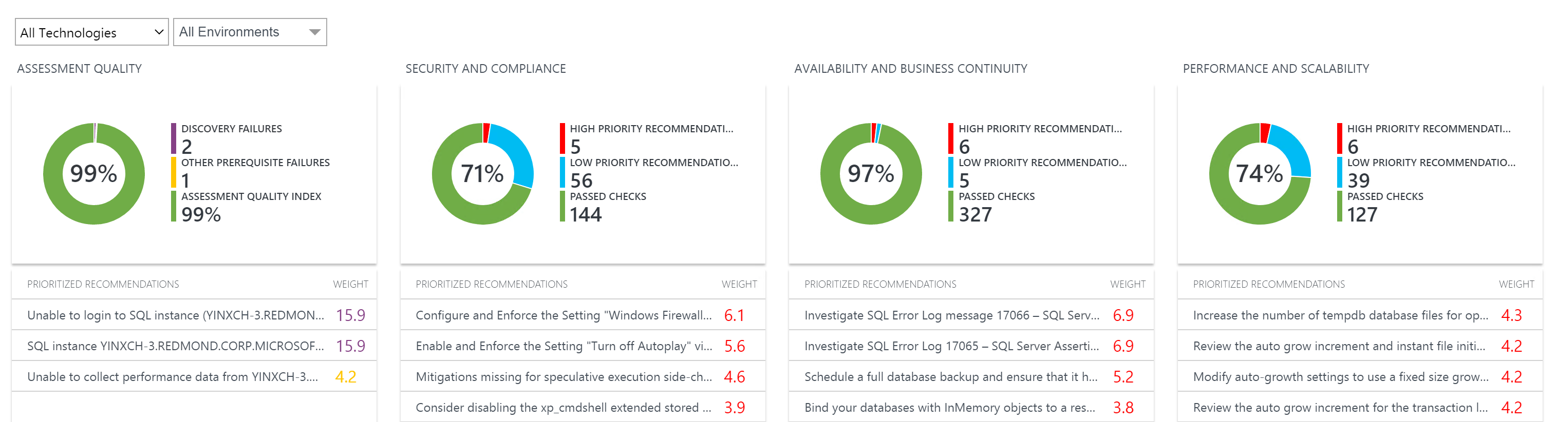
Azure Defender – SQL Vulnerability
SQL vulnerability assessment is an easy-to-configure service that can discover, track, and help you remediate potential database vulnerabilities.
The service employs a knowledge base of rules that flag security vulnerabilities and highlights deviations from best practices, such as misconfigurations, excessive permissions, and unprotected sensitive data.
Assessment Rules cover both database-level issues as well as server-level security issues, like server firewall settings and server-level permissions. These rules also represent many of the requirements from various regulatory bodies to meet their compliance standards.
Notes:
https://docs.microsoft.com/en-us/azure/security-center/deploy-vulnerability-assessment-vm
https://docs.microsoft.com/en-us/azure/azure-sql/database/sql-database-vulnerability-assessment-rules

Slide 46
Azure Purview
Azure Purview is a unified data governance service that helps you manage and govern your on-premises, multi-cloud, and software-as-a-service (SaaS) data.
Easily create a holistic, up-to-date map of your data landscape with automated data discovery, sensitive data classification, and end-to-end data lineage.
Empower data consumers to find valuable, trustworthy data.
Purview Data Map is a cloud native PaaS service that captures metadata about enterprise data present in analytics and operation systems on-premises and cloud.
Data sources supported:
BlobStorage, AzureSQLMI, AzureSQLDB, ADLSGen2, ADLSGen1, Synapse
Notes:
https://docs.microsoft.com/en-us/azure/purview/tutorial-msi-configuration

Slide 47
File Integrity

Slide 48
File Integrity
File integrity monitoring (FIM), also known as change monitoring, examines operating system files, Windows registries, application software, Linux system files, and more, for changes that might indicate an attack.
Security Center recommends entities to monitor with FIM, and you can also define your own FIM policies or entities to monitor.
FIM alerts you for suspicious activity such as:
File and registry key creation or removal
File modifications (changes in file size, access control lists, and hash of the content)
Registry modifications (changes in size, access control lists, type, and the content)

Slide 49
Pop Quiz
Which one of these is NOT a component of a Synapse pipeline?
A) I.R.
B)
Linked Service
C)
Table
D) Activity

Slide 50
Container Image Scanning

Slide 51

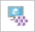
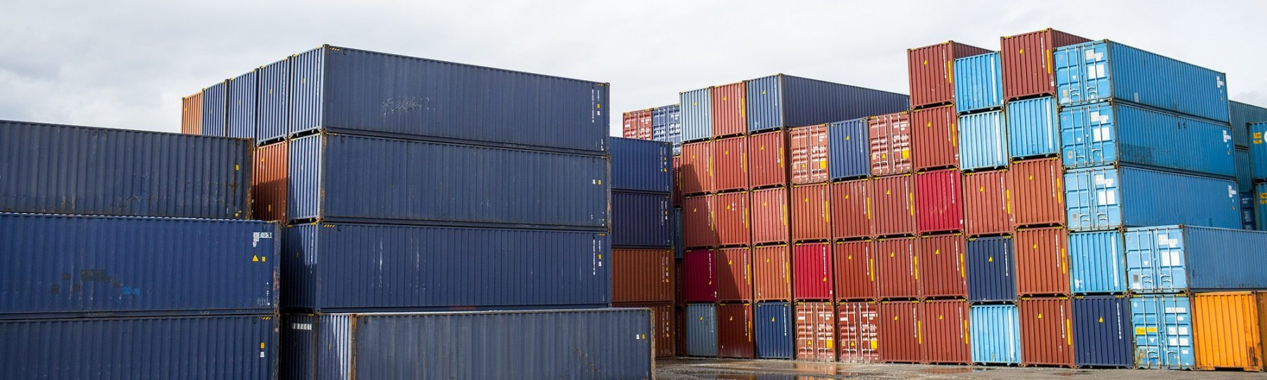
Container Protection
Kubernetes clusters - Continuous assessment of your clusters to provide visibility into misconfigurations and guidelines to help you mitigate identified threats.
Container hosts - Continuous assessment of your Docker environments to provide visibility into misconfigurations and guidelines to help you mitigate threats
Azure Container Registry (ACR) - Vulnerability assessment and management tools for the images in your Azure Resource Manager-based ACR registries

Slide 52
Azure Kubernetes Service
Defends your Kubernetes clusters whether they're hosted in Azure Kubernetes Service (AKS), on-premises, or on other cloud providers. clusters.
Azure Security Center and AKS form a cloud-native Kubernetes security offering with environment hardening, workload protection, and run-time protection
Provides cluster-level threat protection by monitoring your clusters' logs.
Notes:
https://docs.microsoft.com/en-us/azure/security-center/alerts-reference#alerts-k8scluster
https://docs.microsoft.com/en-us/azure/security-center/alerts-reference#alerts-containerhost

Slide 53
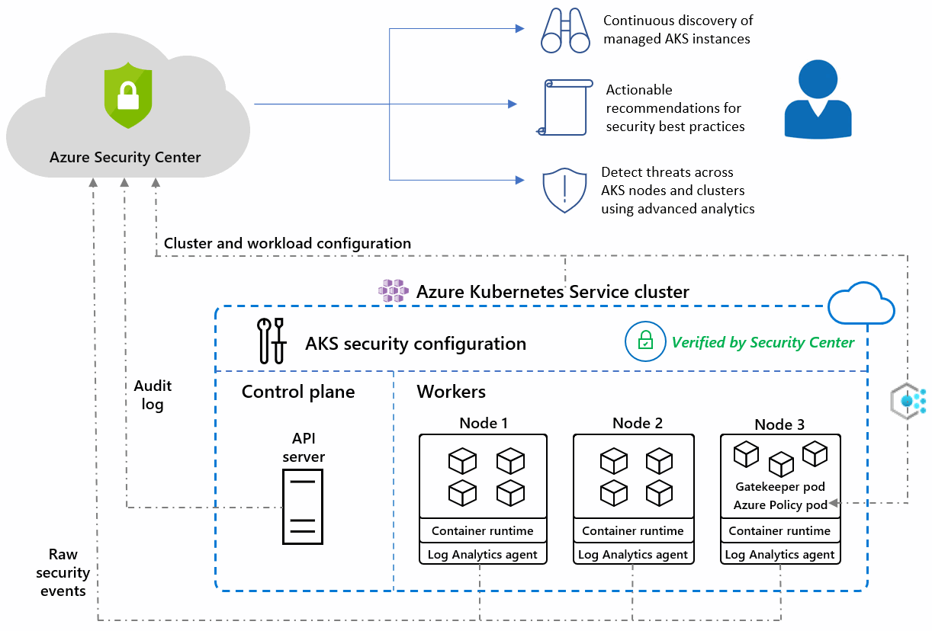
Azure Kubernetes Service
Notes:
https://docs.microsoft.com/en-us/azure/security-center/defender-for-kubernetes-introduction

Slide 54
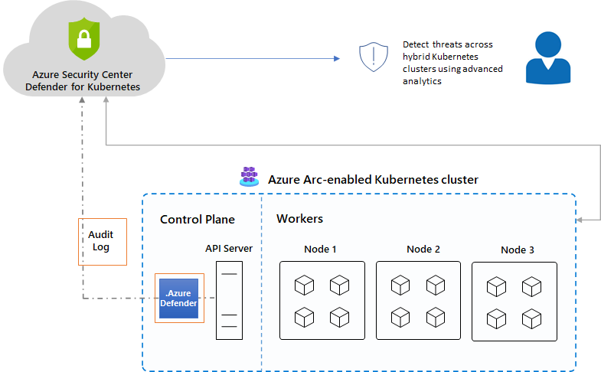
Azure Arc enabled AKS
The Azure Defender for Kubernetes clusters extension can defend your on-premises clusters with the same threat detection capabilities offered for Azure Kubernetes Service clusters.
Notes:
https://docs.microsoft.com/en-us/azure/security-center/defender-for-kubernetes-azure-arc?tabs=k8s-deploy-asc%2Ck8s-verify-asc%2Ck8s-remove-arc

Slide 55
Container Image Scanning
Security Center scans any images pulled within the last 30 days, pushed to your registry, or imported.
The integrated scanner is provided by the industry-leading vulnerability scanning vendor, Qualys.
Findings include related information such as remediation steps, relevant CVEs, CVSS scores, and more.
You can view the identified vulnerabilities for one or more subscriptions, or for a specific registry.
Use the ACR tools to bring images to your registry from Docker Hub or Microsoft Container Registry. When the import completes, the imported images are scanned by Azure Defender.
Notes:
https://docs.microsoft.com/en-us/azure/security-center/defender-for-container-registries-usage

Slide 56
Container Scanning (Docker)
Azure Security Center identifies unmanaged containers hosted on IaaS Linux VMs, or other Linux machines running Docker containers.
When you're exploring the security issues of a VM, Security Center provides additional information about the containers on the machine. Such information includes the Docker version and the number of images running on the host.
Security Center includes the entire ruleset of the CIS Docker Benchmark and alerts you if your containers don't satisfy any of the controls. When it finds misconfigurations, Security Center generates security recommendations.
The CIS benchmark checks don't run on AKS-managed instances or Databricks-managed VMs.

Slide 57
Adaptive Application Control
Notes:
Back to me

Slide 58
Adaptive Application Control
Intelligent and automated solution for defining allow lists of known-safe applications for your machines.
Uses machine learning to analyze the applications running on your machines and create a list of the known-safe software.
By defining lists of known-safe applications, and generating alerts when anything else is executed, you can achieve multiple hardening goals:
Identify potential malware, even any that might be missed by antimalware solutions
Improve compliance with local security policies that dictate the use of only licensed software
Avoid running old or unsupported applications
Prevent specific software that's banned by your organization
Increase oversight of apps that access sensitive data
Notes:
No enforcement options are currently available. Adaptive application controls are intended to provide security alerts if any application runs other than the ones you've defined as safe.

Slide 59


Question…
How often does Adaptive Application controls calculate events?
Notes:
Adaptive application controls calculates events once every twelve hours.
The activity start time shown in the alerts page is the time that adaptive application controls created the alert, not the time that the suspicious process was active.

Slide 60
Adaptive Network Hardening
Notes:
Back to me

Slide 61
Adaptive Network Hardening
Adaptive network hardening is an agentless feature of Azure Security Center - nothing needs to be installed on your machines to benefit from this network hardening tool.
Provides recommendations to further harden NSG rules.
It uses a machine learning algorithm that factors in actual traffic, known trusted configuration, threat intelligence, and other indicators of compromise, and then provides recommendations to allow traffic only from specific IP/port tuples.
Adaptive network hardening recommendations are only supported on specific ports.
Notes:
Ports : 13, 17, 19, 22, 23, 53, 69, 81, 111, 119, 123, 135, 137, 138, 139, 161, 162, 389, 445, 512, 514, 593, 636, 873, 1433, 1434, 1900, 2049, 2301, 2323, 2381, 3268, 3306, 3389, 4333, 5353, 5432, 5555, 5800, 5900, 5900, 5985, 5986, 6379, 6379, 7000, 7001, 7199, 8081, 8089, 8545, 9042, 9160, 9300, 11211, 16379, 26379, 27017, 37215

Slide 62
Just In Time VM Access
Notes:
Back to me

Slide 63
JIT VM Access
Lock down inbound traffic to your Azure Virtual Machines with Azure Security Center's just-in-time (JIT) virtual machine (VM) access feature.
Select the ports on the VM to which inbound traffic will be blocked.
Ensures "deny all inbound traffic" rules exist for your selected ports in the network security group (NSG) and Azure Firewall rules.
When a user requests access to a VM, Security Center checks that the user has Azure role-based access control (Azure RBAC) permissions for that VM.
If the request is approved, Security Center configures the NSGs and Azure Firewall to allow inbound traffic to the selected ports from the relevant IP address (or range), for the amount of time that was specified
After the time has expired, Security Center restores the NSGs to their previous states. Connections that are already established are not interrupted.

Slide 64
Network Map
Notes:
Back to me

Slide 65
Network Map
Provides a graphical view with security overlays giving you recommendations and insights for hardening your network resources.
Using the map you can see the network topology of your Azure workloads, connections between your virtual machines and subnets, and the capability to drill down from the map into specific resources and the recommendations for those resources.
The network map can show you your Azure resources in a Topology view and a Traffic view.

Slide 66
Topology View
In the inner circle, you can see all the Vnets within your selected subscriptions, the next circle is all the subnets, the outer circle is all the virtual machines.
The lines connecting the resources in the map let you know which resources are associated with each other, and how your Azure network is structured.
If there are too many resources being displayed on the map, Azure Security Center uses its proprietary algorithm to smart cluster your resources, highlighting the resources that are in the most critical state, and have the highest severity recommendations.

Slide 67
Traffic View
The Traffic view provides you with a map of all the possible traffic between your resources.
This provides you with a visual map of all the rules you configured that define which resources can communicate with whom.
View existing configuration of the network security groups as well as quickly identify possible risky configurations within your workloads.
The strength of this view is in its ability to show you these allowed connections together with the vulnerabilities that exist, so you can use this cross-section of data to perform the necessary hardening on your resources.
For example, you might detect two machines that you weren’t aware could communicate, enabling you to better isolate the workloads and subnets.

Slide 68
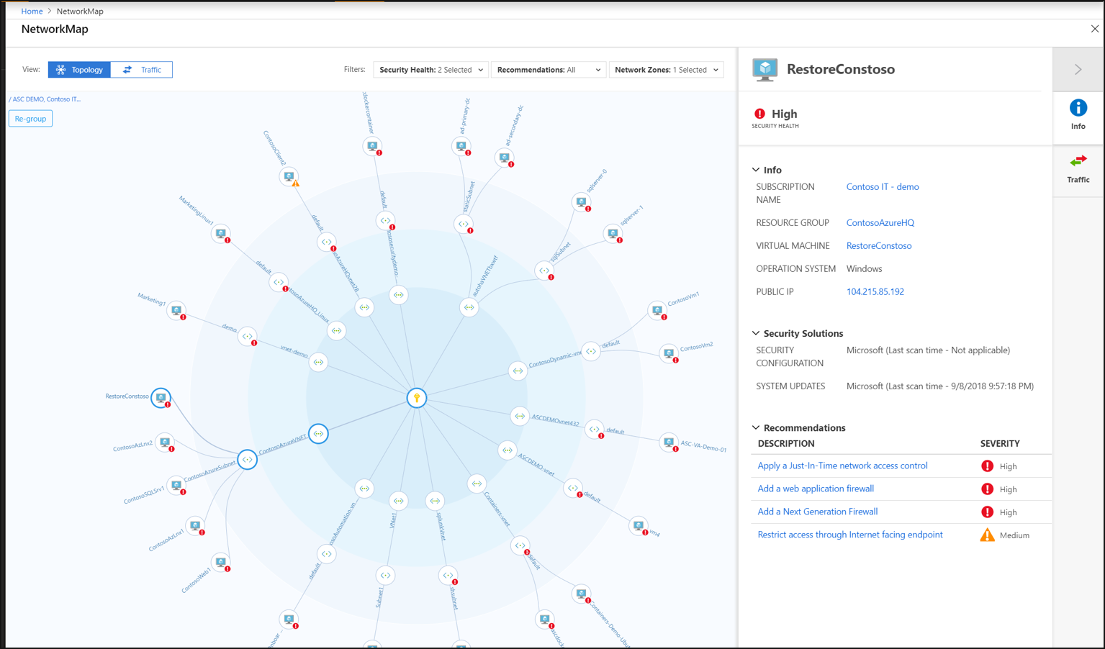
Network Map

Slide 69
Azure Policy
Notes:
Back to me

Slide 70

Azure Policy
Azure Policy helps to enforce organizational standards and to assess compliance at-scale. Through its compliance dashboard, it provides an aggregated view to evaluate the overall state of the environment, with the ability to drill down to the per-resource, per-policy granularity. It also helps to bring your resources to compliance through bulk remediation for existing resources and automatic remediation for new resources.
Common use cases for Azure Policy include implementing governance for resource consistency, regulatory compliance, security, cost, and management.

Slide 71
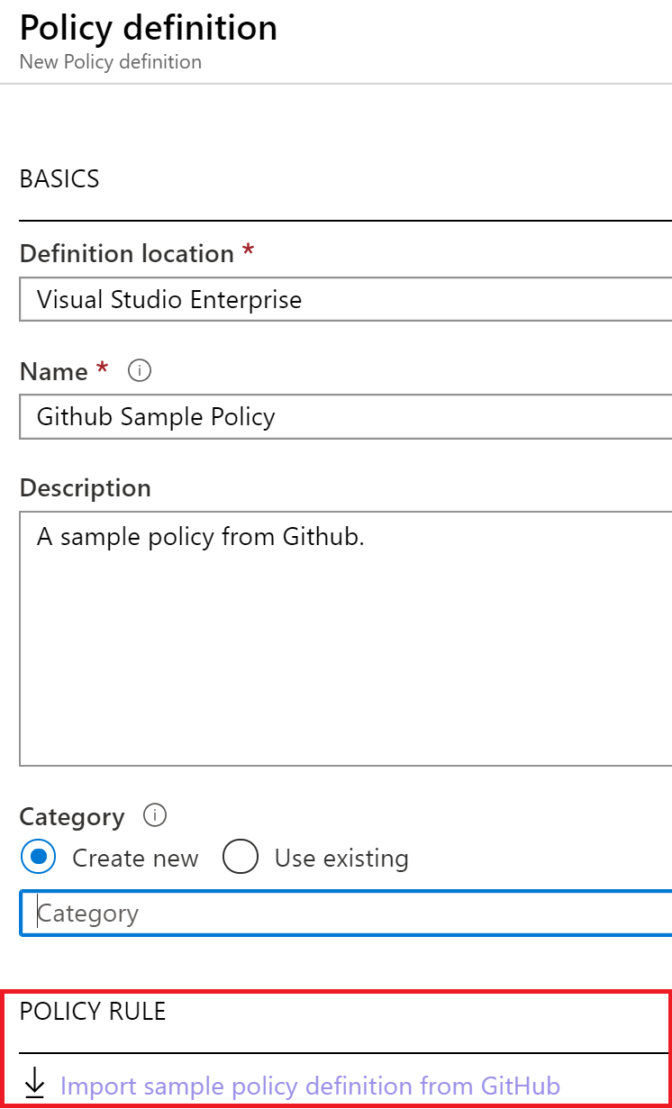
Policy Definitions
Many policy definitions are available.
You can import policies from GitHub.
Policy definitions have a specific JSON format.
You can create custom policy definitions.

Slide 72
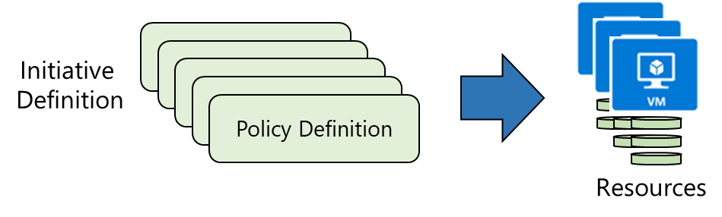
Initiative Definitions
An initiative definition is a collection of policy definitions that are tailored toward achieving a singular overarching goal. Initiative definitions simplify managing and assigning policy definitions. They simplify by grouping a set of policies as one single item.
For example, you could create an initiative titled Enable Monitoring in Azure Security Center, with a goal to monitor all the available security recommendations in your Azure Security Center.

Slide 73
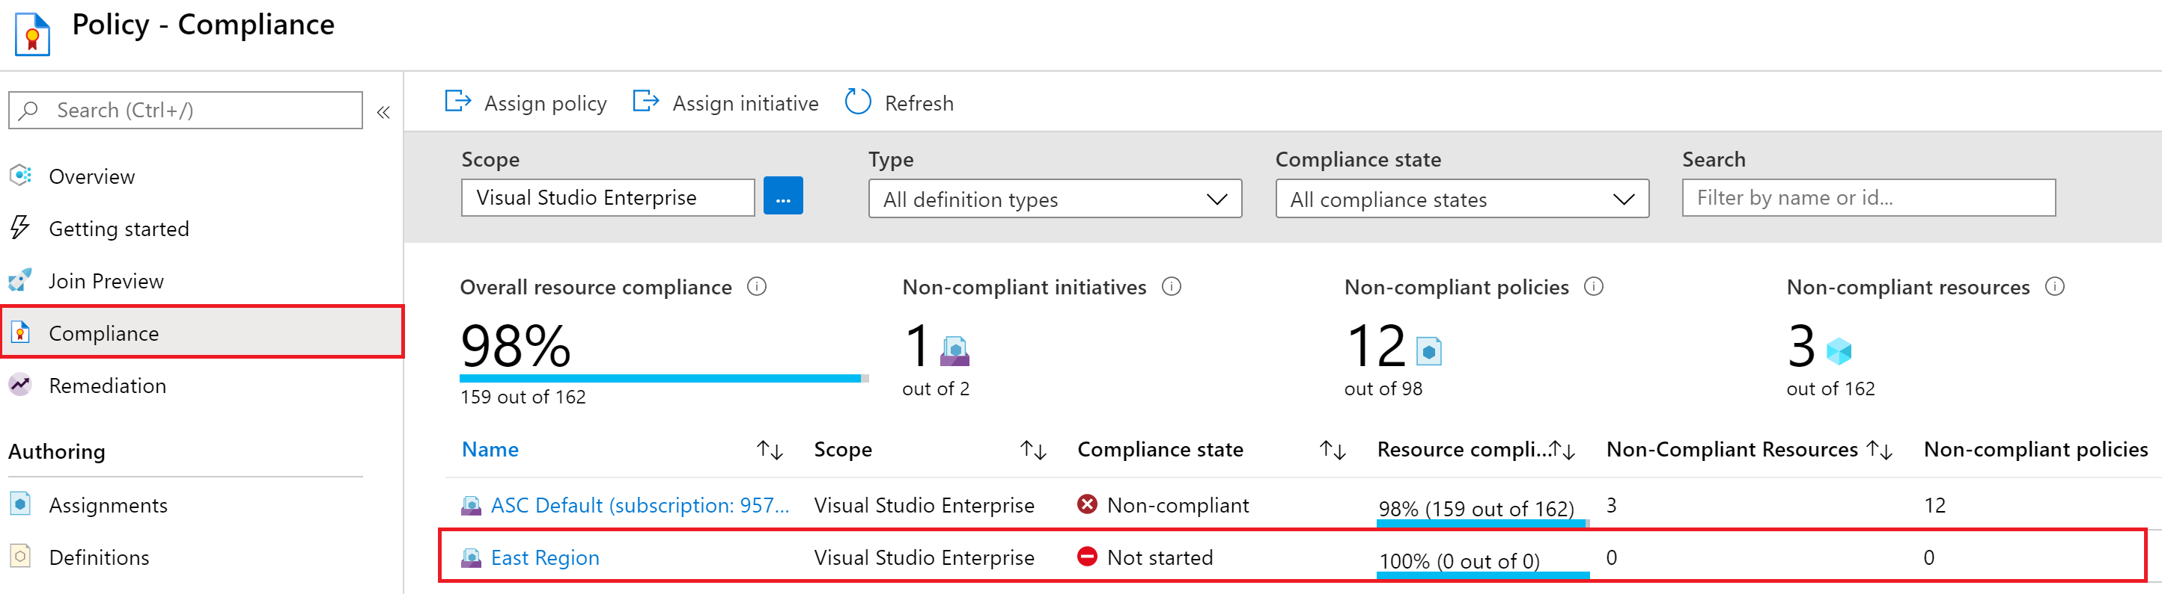
Azure Defender + Azure Policy
Many of the control plane protections in Azure Defender utilize Azure Policy for evaluated resources or applying compliance standards. Azure Security Center Policies are stored in the ASC Default policy.

Slide 74
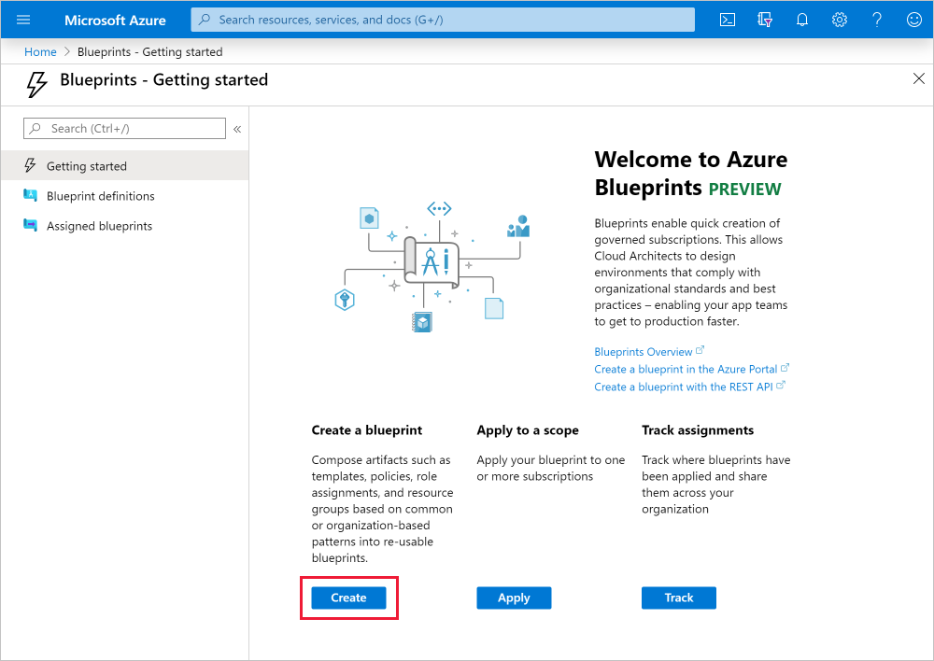
Azure Blueprints
Azure Blueprints is a declarative way to orchestrate the deployment of such artifacts as policy
Role assignments Policy assignments ARM templates
Resource groups
How is this different from ARM templates?
How is this different from Azure policy?

Slide 75
IoT Security
Notes:
Back to me

Slide 76
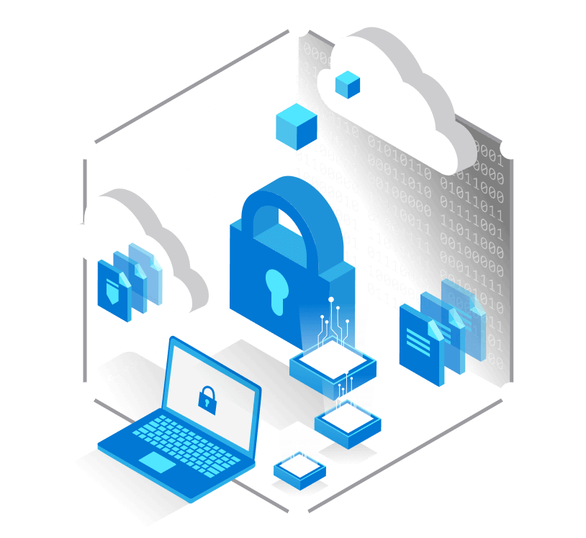
Azure Defender for IoT
Defender for IoT connects both to the Azure cloud and to on-premises components.
The solution is designed for scalability in large and geographically distributed environments with multiple remote locations.
This solution enables a multi-layered distributed architecture by country, region, business unit, or zone.
Provides both agent and agentless solutions with cloud and offline deployments
Notes:
https://docs.microsoft.com/en-us/azure/defender-for-iot/architecture

Slide 77
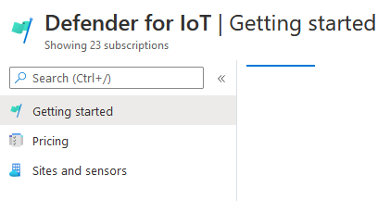
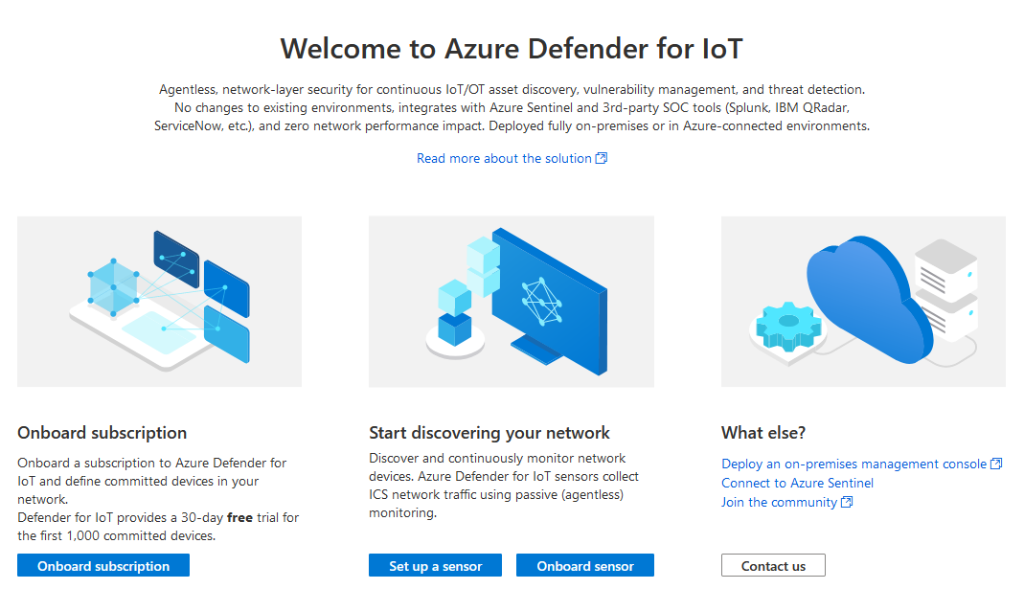
Azure Defender for IoT - Portal
The Azure Defender for IoT is a separate Portal outside of the Azure Security Center.
Notes:
https://portal.azure.com/#blade/Microsoft_Azure_IoT_Defender/IoTDefenderDashboard/Getting_Started

Slide 78
Agentless-based (IoT Sensors)
The Defender for IoT sensors discover, and continuously monitor network devices.
Sensors collect ICS network traffic using passive (agentless) monitoring on IoT and OT devices.
Purpose-built for IoT and OT networks, the agentless technology delivers deep visibility into IoT and OT risk within minutes of being connected to the network.
It has zero performance impact on the network and network devices due to its non-invasive, Network Traffic Analysis (NTA) approach.

Slide 79
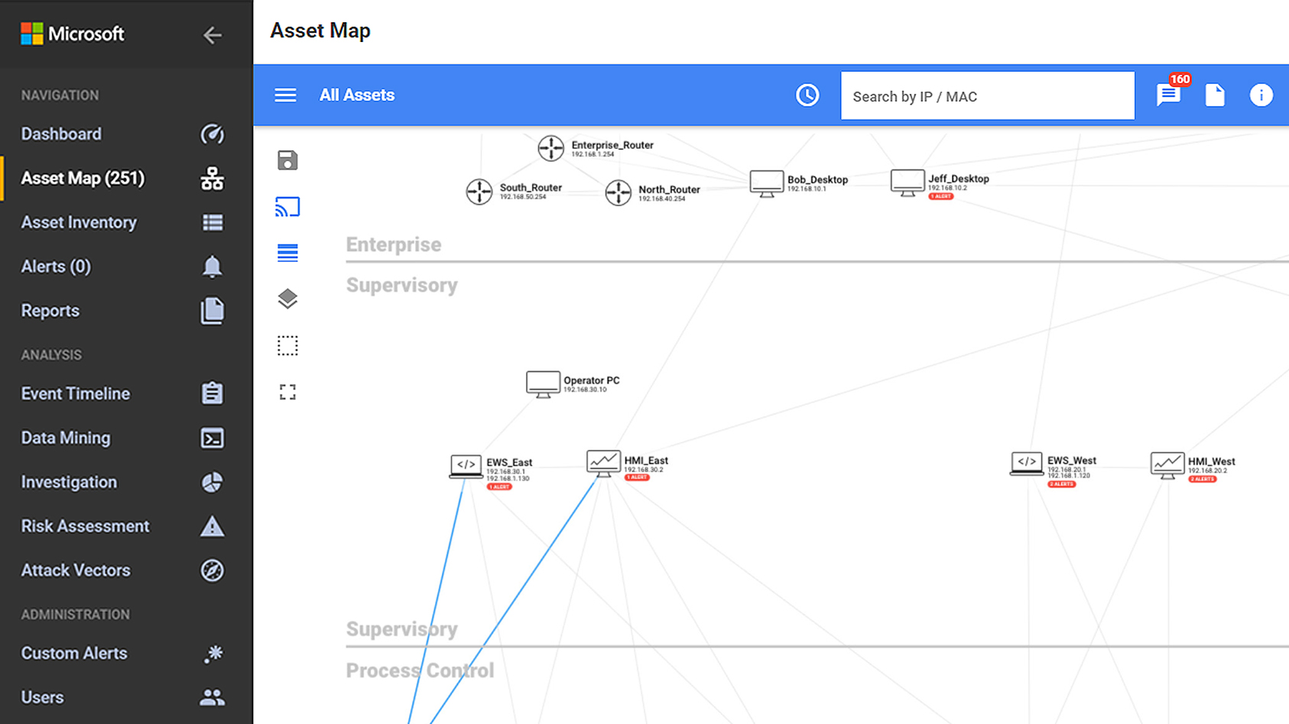
Device Discovery
Use passive, agentless network monitoring to gain a complete inventory of all your IoT/OT assets, with zero impact on the IoT/OT network.
Analyze diverse industrial protocols to identify device details including manufacturer, type, serial number, firmware level, and IP or Media Access Control (MAC) address.
Visualize your entire IoT/OT network topology, see device communication paths, and quickly identify the root cause of operational issues such as misconfigured devices.

Slide 80
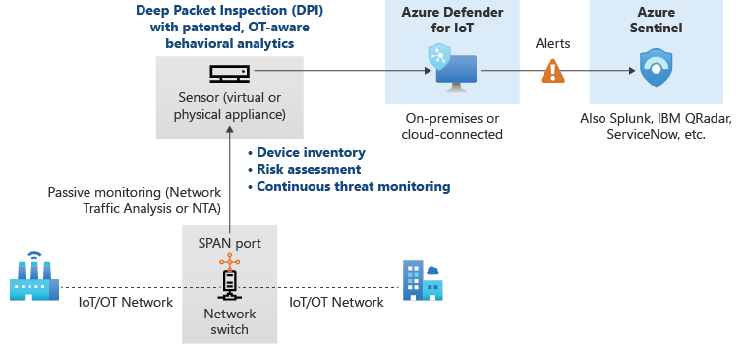
Offline

Slide 81
Azure IoT Hub
Enable highly secure and reliable communication between your Internet of Things (IoT) application and the devices it manages.
Azure IoT Hub provides a cloud-hosted solution back end to connect virtually any device.
Extend your solution from the cloud to the edge with per-device authentication, built-in device management, and scaled provisioning.

Slide 82
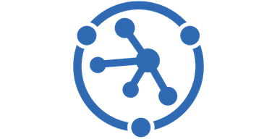
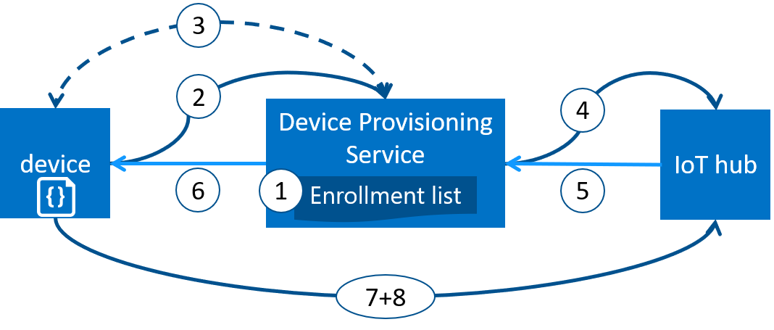
Azure IoT Device Provisioning
Microsoft Azure provides a rich set of integrated public cloud services for all your IoT solution needs. The IoT Hub Device Provisioning Service (DPS) is a helper service for IoT Hub that enables zero-touch, just-in-time provisioning to the right IoT hub without requiring human intervention. DPS enables the provisioning of millions of devices in a secure and scalable manner.

Slide 83
Azure IoT Security Agent
ASC for IoT provides reference architecture for security agents that log, process, aggregate, and send security data through IoT hub. Security agents are designed to work in a constrained IoT environment, and are highly customizable in terms of values they provide when compared to the resources they consume.
Security agents support the following IoT solution features:
Collect raw security events from the underlying OS (Linux, Windows). To learn more about available security data collectors, see ASC for IoT agent configuration.
Aggregate raw security events into messages sent through IoT hub.
Authenticate with existing device identity, or a dedicated module identity.
Configure remotely through use of the atpforiot module twin.
https://github.com/Azure/Azure-IoT-Security-Agent-C

Slide 84
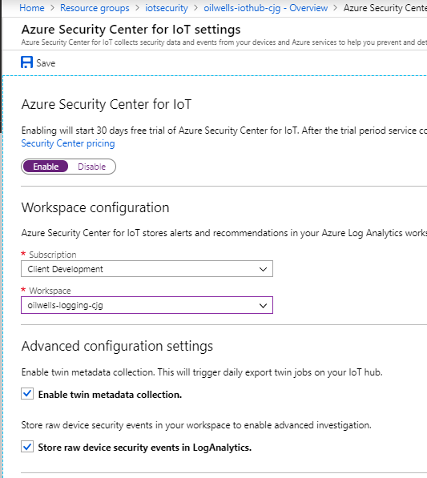
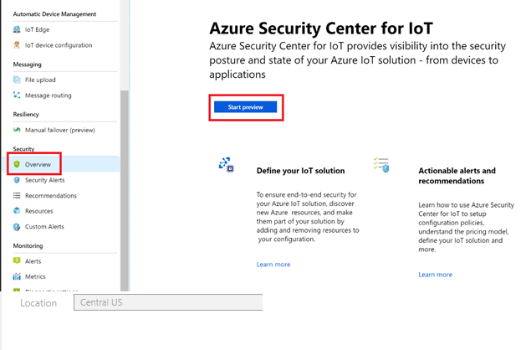
Azure Security Center + Security Agent
Azure Security Center alerts and recommendations and device log data is sent to Log Analytics.

Slide 85

Azure Sphere
Azure Sphere is a secured, high-level application platform with built-in communication and security features for internet-connected devices.
It comprises a secured, connected, crossover microcontroller unit (MCU), a custom high-level Linux-based operating system (OS), and a cloud-based security service that provides continuous, renewable security.
Notes:
https://docs.microsoft.com/en-us/azure-sphere/product-overview/what-is-azure-sphere

Slide 86

Security Baseline (IoT)
The Azure Security Benchmark provides recommendations on how you can secure your cloud solutions on Azure.
Content is grouped by the security controls defined by the Azure Security Benchmark and the related guidance applicable to Azure IoT Hub.
https://docs.microsoft.com/en-us/security/benchmark/azure/baselines/iot-hub-security-baseline?toc=/azure/iot-hub/TOC.json
Notes:
https://docs.microsoft.com/en-us/security/benchmark/azure/baselines/iot-hub-security-baseline?toc=/azure/iot-hub/TOC.json

Slide 87
Recommendations

Slide 88


Recommendations
All of the previously discussed Azure Defender solutions will evaluate either the control or data plane of Azure or non-Azure resources and generate security recommendations based on that particular resources best practices.
Recommendations give you suggestions on how to better secure your resources. You implement a recommendation by following the remediation steps provided in the recommendation.
Recommendations can have automation remediation tasks or require manual intervention, however the Fix feature is only available for specific recommendations.

Slide 89
Disable Recommendations
Occasionally, a resource will be listed that you feel shouldn't be included. Or a recommendation will show in a scope where you feel it doesn't belong.
Example: The resource might have been remediated by a process not tracked by Security Center. The recommendation might be inappropriate for a specific subscription. Or perhaps your organization has simply decided to accept the risks related to the specific resource or recommendation.
Exempt a resource to ensure it isn't listed with the unhealthy resources in the future, and doesn't impact your secure score. The resource will be listed as not applicable and the reason will be shown as "exempted" with the specific justification you select.
Exempt a subscription or management group to ensure that the recommendation doesn't impact your secure score and won't be shown for the subscription or management group in the future. This relates to existing resources and any you create in the future. The recommendation will be marked with the specific justification you select for the scope that you selected.
Recommendations that are generated from any custom initiatives assigned to your subscriptions cannot be exempted
Notes:
https://docs.microsoft.com/en-us/azure/security-center/exempt-resource

Slide 90
Azure Policy
TODO

Slide 91
Question…
Do preview recommendations render a resource unhealthy?
Are they calculated in your secure score?
Notes:
Preview recommendations don't render a resource unhealthy, and they aren't included in the calculations of your secure score.
Remediate them wherever possible, so that when the preview period ends they'll contribute towards your score.
Learn more about how to respond to these recommendations in Remediate recommendations in Azure Security Center.

Slide 92
Question…
What could be the issue if you disable a policy recommendation at the subscription level yet the recommendations are still showing up?
Notes:
Remember that a management group applies its policies to its subscriptions.
Therefore, if you disable a subscription's policy, and the subscription belongs to a management group that still uses the same policy, then you will continue to receive the policy recommendations.
The policy will still be applied from the management level and the recommendations will still be generated.

Slide 93
Azure Security Center + Azure Defender – Case Studies
Notes:
https://azure.microsoft.com/en-us/case-studies/?term=azure+security+center

Slide 94

Case Studies - NCR
“The moment a solution is installed in the Azure environment, it becomes integrated with Azure Security Center and shows up in the centralized dashboard as an element for us to address in our security posture.”
To help secure storage, IT staff set up Azure Defender for SQL, which provides vulnerability assessments and advanced protection against threats like SQL injection attacks. NCR has a data lake, storage blobs, and containers in Azure that it uses across different solutions. It also has Azure SQL databases, some of which are backed by hyperscale storage technology to handle fluctuations in demand.
The biggest benefits of Azure Security Center are centralized security with visibility into entire deployments. And every time we bring a new solution into the cloud, we automate security. We don’t have to have teams writing or installing configuration management tools; we have a more agile approach to the cloud using an infrastructure-as-code methodology with Azure Resource Manager.
Notes:
https://customers.microsoft.com/en-us/story/1332078004907432948-ncr-corporation-professional-services-azure-security-center

Slide 95

Case Studies - Centro Paula Souza
We had a good visibility on the technical side about how a tool like Azure Security Center would help us, and how the implementation was quick, agile and transparent, without causing any problems in our structure.
From the user’s perspective it gave us visibility. We identified, for example, machines in the schools that were being used for bitcoin mining
On average CPS’s Azure Security Center captures more than 588 million security events per week, identifying between 15 to 30 really critical events, such as brute-force attacks.

Slide 96
DEMO: How to whiteboard designs

Slide 97
Breakout Activity: Azure Defender
As a result of participating in this activity, you will better be able to apply Azure Defender features to a customer scenerio
OUTCOMES
ACTIVITY
45 minutes
Learning Adviser
Table Group Channel
As a team review WWI requirements provided in student guide
Open the whiteboard and as a team answer the provided challenge questions.
The questions are pre-loaded into the whiteboard.
Welcome | Keynote | Demo Walkthrough | Break | Azure Security Center, Defender, Arc, Lighthouse | Break | Azure Defender Solutions | Activity: Azure Defender Solutions | Long Break | Azure Sentinel | Activity: Azure Sentinel | Lab: Azure Defender, Azure Sentinel | Closing

Slide 98
Thank You slide
Long Break (60 mins)

Slide 99
Welcome Back!
Kick-Off | 8:00-8:05 | Welcome | Main Call
 | 8:05-8:30 | Security Center + Azure Defender
 | 8:30-8:45 | Demo Walkthrough
High-Level | 8:45-9:00 | Break
 | 9:00-10:00 | Azure Security Center, Defender, Arc, Lighthouse
 | 10:00-10:15 | Break
 | 10:15-11:15 | Azure Defender Solutions
 | 11:15-12:00 | Activity: Azure Defender Solutions | Table Group Call
Getting Technical | 12:00-1:00 | Long Break | Main Call
 | 1:00-1:30 | Azure Sentinel
 | 1:30-2:15 | Activity: Azure Sentinel | Table Group Call
 | 2:15-4:00 | Build Hands-on: Azure Defender, Azure Sentinel | Table Group Call
 | 4:00-4:15 | Closing | Main Call
Presentation/
Whole Group
Lab
Activity/ Discussion/ Group Work
Announcements

Slide 100
Azure Sentinel

Slide 101

Azure Sentinel
Scalable, cloud-native, security information event management (SIEM) and security orchestration automated response (SOAR) solution. Azure Sentinel delivers intelligent security analytics and threat intelligence across the enterprise, providing a single solution for alert detection, threat visibility, proactive hunting, and threat response.
Azure Sentinel is your birds-eye view across the enterprise alleviating the stress of increasingly sophisticated attacks, increasing volumes of alerts, and long resolution time frames.
Notes:
TODO

Slide 102
The Concept of SIEM, SOAR and XDR
SIEMs are used for real-time security event analysis to help with investigation, early threat detection and incident response. They also support compliance use cases, as many data regulatory frameworks require organizations to keep audit logs for up to one year.
The key capabilities of SOAR solutions include threat management (help mitigate vulnerabilities), incident response (managing and coordinating response to a security incident) and security operations automation (overall orchestration of workflows, policy execution and reporting).
XDRs centralize normalized data, mostly focusing on products from their own ecosystem. They provide correlated data and alerts into security incidents, and they provide an incident response functionality that can be carried out via security policies.

Slide 103
Security Orchestration Automation and Response (SOAR)
SIEM/SOC teams are typically inundated with security alerts and incidents on a regular basis, at volumes so large that available personnel are overwhelmed.
This results all too often in situations where many alerts are ignored and many incidents aren't investigated, leaving the organization vulnerable to attacks that go unnoticed.
Azure Sentinel, in addition to being a Security Information and Event Management (SIEM) system, is also a platform for Security Orchestration, Automation, and Response (SOAR).
One of its primary purposes is to automate any recurring and predictable enrichment, response, and remediation tasks that are the responsibility of your Security Operations Center and personnel (SOC/SecOps), freeing up time and resources for more in-depth investigation of, and hunting for, advanced threats.
Notes:
TODO

Slide 104
Why Sentinel?
#1 - Better value for money
Help lower business overheads related to security posture almost immediately after adoption because of its scalable, fully managed nature.
#2 - Seamless security integrations.
Office 365, Log Analytics, Cloud App Security, Palo Alto, ServiceNow, SumoLogic, etc
#3 - Meets the needs for both IT Security and decision-makers
Security teams can get alerts in real time, remediate problems more efficiently using ML and AI-enhanced automation, and use query language for more proactive identification of threats and anomalies.
Business leaders can access relevant data across the business using Azure Sentinel’s visualized and interactive dashboards, which saves time having to source reports from different departments
Notes:
TODO

Slide 105


Slide 106


Slide 107





Latest innovations
Helping you stay ahead of threats
Analytics
Behavioral Analytics (UEBA) Entity Search and Profiles New ML Fusion Scenarios
Jupyter Notebooks Powered by Azure ML
Intelligence
Threat Indicator Management Integrated Threat Intelligence from Threat
Quotent, Recorded Future, RiskIQ
Watchlists
Data Collection
Network Schema (OSSEM) Logstash Output Plug-In
Connectors for: Microsoft Teams, Microsoft 365 Defender Endpoint, CyberArk, NetScaler, ForgeRock, & Beyond Security

Slide 108






End-to-end solution for security operations
Detect
Collect
Visibility
Investigate
Incidents
Respond
Automation
Analytics
Hunting
Powered by community + backed by Microsoft’s security experts

Slide 109


Azure Sentinel vs Azure Security Center with Azure Defender
Cybersecurity Cycle
Visibility
Analytics
Hunting
Incidents
Automation
Azure Security Center
Azure Sentinel

Slide 110
Azure Sentinel
Things that you can NOT do:
You can NOT use the same Log Analytics Workspace that is used by Azure Security Center
Once Azure Sentinel is enabled on a workspace, you can NOT move the workspace to another resource group or subscription (you have to contact Azure Sentinel Support Team to accomplish this task)
Notes:
TODO

Slide 111

Azure Sentinel - Connectors
Over 100+ Data Connectors available for Azure Sentinel
Not only for Azure connection but external services as well.
Notes:
TODO

Slide 112

Azure Sentinel - Connectors
Example: Azure Active Directory Connector:
Notes:
TODO

Slide 113

Azure Sentinel - Connectors
Example: Security Events Connector:
Notes:
TODO

Slide 114

Azure Sentinel - Connectors
Example: Office 365

Slide 115


Logging - Focus on what’s important

Slide 116
Azure Sentinel - Incidents
Azure Sentinel incidents are containers of threats in your organization – alerts, entities and any additional related evidence.
An incident is created based on alerts that you have defined in the security analytics page. The properties related to the alerts, such as severity and status are set at the incident level.
Activities related to events include:
View related alerts - View all related alerts that are aggregated into an incident based on the alert trigger definition of the alert fusion strategy enabled
Triage and investigate - Review all related entities in the incident and additional contextual information meaningful to the triage process.
Incident Management - Manage the lifecycle of the incident – assign to yourself for further investigation, change the status of the incident and update its severity after triage.
Respond to alerts - Trigger playbooks on the alerts grouped in the incident to resolve the threat detected by the alert using playbooks.
Notes:
TODO

Slide 117
Question…
What is the maximum number of alerts an Azure Sentinel Incident can contain?
Notes:
Incidents in Azure Sentinel can contain a maximum of 150 alerts. Microsoft 365 Defender incidents can have more than this. If a Microsoft 365 Defender incident with more than 150 alerts is synchronized to Azure Sentinel, the Sentinel incident will show as having “150+” alerts and will provide a link to the parallel incident in Microsoft 365 Defender where you will see the full set of alerts.
https://docs.microsoft.com/en-us/azure/sentinel/microsoft-365-defender-sentinel-integration?view=o365-worldwide

Slide 118

Azure Sentinel - Workbooks
Azure Sentinel integrates with Azure Monitor Workbooks
You can create Workbooks across your Data
Azure Sentinel comes with Workbook templates to allow for quick insight gain right after connecting the data.
Notes:
TODO

Slide 119

Azure Sentinel - Hunting
Over 195 pre-defined queries helpful for hunting for potential threats in your log data
Defined based on the MITRE ATTACK framework tactics and techniques
Keeps track of deltas (previous results)
Queries should not have time defined in the KQL query
Livestream allows for a user session-based, user interface driven feature that allows an Azure Sentinel user to quickly create a Livestream session using any Log Analytics query.
Test newly created queries, elevate to alerts once tested
Allows for quick testing without custom alert rule overhead
Target an entity for live streaming during an investigation
https://github.com/Azure/Azure-Sentinel/tree/master/Hunting%20Queries
Notes:
https://docs.microsoft.com/en-us/azure/sentinel/hunting
https://github.com/Azure/Azure-Sentinel/tree/master/Hunting%20Queries

Slide 120

Hunting Queries
Over 195 pre-defined hunting queries curated by Microsoft security experts.
Azure Sentinel’s Hunting Queries is a differentiation point as compared to other SIEM solutions.
These queries help in the migration process as they reduce some of the work of migrating source queries.

Slide 121

Azure Sentinel - Notebooks
Julia Python and R ➔ Jupyter Notebooks
When to use Notebooks in Sentinel?
When triaging an incident in Azure Sentinel comes to a dead end.
Your investigation become significantly more complex
When automation ends and there is a need to find a needle in a haystack
Too much details to go through
Need persistence to pass results to the next analyst
KQL is no longer cutting it
Need to integrate with external data (WhoIs, GeoIP, etc…) not stored in the workspace
Need for ML and visualizations available already in the form of 1000s of libraries and packages.
Notes:
Notebooks in Azure Sentinel are based on Jupyter notebooks based on Julia Python and R languages.

Slide 122


Azure Sentinel – Notebooks …
You can use Visual Studio Code to develop your Notebooks.
You can use a Local Docker Container to developer locally disconnected.
You can use %kql as a magic command to continue using your queries in the notebooks

Slide 123

Azure Sentinel – Notebooks …

Slide 124

Azure Sentinel – Notebooks …
Notes:
Choosing the ML Template Notebook to use with Azure Sentinel
You have to choose a Compute to start using the Notebook
You will need to Authenticate from the notebook to use any Azure SDK

Slide 125

Azure Sentinel – Entity Behavior
Notes:
TODO

Slide 126

Azure Sentinel – Entity Behavior – Use Cases
Notes:
TODO

Slide 127


Slide 128
Question…
Can you install Azure Sentinel on the default workspace created by Azure Security Center?
Notes:
Default workspaces created by Azure Security Center will not appear in the list; you can't install Azure Sentinel on them.
https://docs.microsoft.com/en-us/azure/sentinel/quickstart-onboard?view=o365-worldwide

Slide 129


Slide 130


Slide 131


Slide 132
Azure Sentinel – Threat Intelligence
Azure Sentinel lets you import the threat indicators your organization is using, which can enhance your security analysts' ability to detect and prioritize known threats.
You can stream threat indicators to Azure Sentinel by using one of the integrated threat intelligence platform (TIP) products, connecting to TAXII servers, or by using direct integration with the Microsoft Graph Security tiIndicators API.
Mitre Attack Framework utilize STIX and TAXII feeds to import data.
Notes:
TODO

Slide 133
Microsoft Graph - tiIndicator
The Microsoft Graph Security API tiIndicators entity allows you to upload your threat indicators to Microsoft security tools for the actions of allow, block, or alert.
TargetProduct can be Azure Sentinel or Microsoft Defender
Limit of 15000 indicators per tenant
The following indicator types are supported:
Files
IP addresses: Microsoft Defender ATP supports destination IPv4/IPv6 only – set property in networkDestinationIPv4 or networkDestinationIPv6 properties
URLs/domains
Notes:
https://docs.microsoft.com/en-us/graph/api/resources/tiindicator?view=graph-rest-beta

Slide 134


Threat Intelligence Storage
Once imported, Threat Intelligence data is stored in Log Analytics and can be queried:
Notes:
https://docs.microsoft.com/en-us/graph/api/resources/tiindicator?view=graph-rest-beta

Slide 135

Azure Sentinel – Analytics
Azure Sentinel provides out-of-the-box, built-in templates to help you create threat detection rules.
These templates were designed by Microsoft's team of security experts and analysts based on known threats, common attack vectors, and suspicious activity escalation chains.
Rules created from these templates will automatically search across your environment for any activity that looks suspicious.
Many of the templates can be customized to search for activities, or filter them out, according to your needs.
The alerts generated by these rules will create incidents that you can assign and investigate in your environment.
Notes:
TODO

Slide 136

Azure Sentinel – Fusion
Based on Fusion technology, advanced multistage attack detection in Azure Sentinel uses scalable machine learning algorithms that can correlate many low-fidelity alerts and events across multiple products into high-fidelity and actionable incidents.
Notes:
https://docs.microsoft.com/en-us/azure/sentinel/tutorial-detect-threats-built-in?WT.mc_id=Portal-Microsoft_Azure_Security_Insights

Slide 137

How Fusion Works - Construct graph
Fusion gathers all the low and medium level alerts detected in a 30-day window and creates a graph.
The graph is hyperconnected and consists of billions of vertices and edges. Each entity is represented by a vertex (or node).
For example, a vertex could be a user, an IP address, a virtual machine (VM), or any other entity within the network. The edges (or links) represent all the activities. If a user accesses company resources with a mobile device, both the device and the user are represented as vertices connected by an edge.
Notes:
https://www.microsoft.com/security/blog/2020/02/20/azure-sentinel-uncovers-real-threats-hidden-billions-low-fidelity-signals/

Slide 138
How Fusion Works – Kill Chain
Fusion applies a probabilistic kill chain which acts as a regularizer to the graph.
The statistical analysis is based on how real people—Microsoft security experts, vendors, and customers—triage alerts.
For example, defenders prioritize kill chains that are time bound. If a kill chain is executed within a day, it will take precedence over one that is enacted over a few days. An even higher priority kill chain is one in which all steps have been completed.
This intelligence is encoded into the Fusion machine learning statistical model. Once the probabilistic kill chain is applied, Fusion outputs a smaller number of sub graphs, reducing the number of threats from billions to hundreds.
Notes:
https://www.microsoft.com/security/blog/2020/02/20/azure-sentinel-uncovers-real-threats-hidden-billions-low-fidelity-signals/

Slide 139
How Fusion Works – Score Attack
To reduce the noise further, Fusion uses machine learning to apply a final round of scoring. If labeled data exists, Fusion uses random forests. Labeled data for attacks is generated from the extensive Azure red team that execute these scenarios. If labeled data doesn’t exist Fusion uses spectral clustering.
Some of the criteria used to elevate threats include the number of high impact activity in the graph and whether the subgraph connects to another subgraph.
The output of this machine learning process is tens of threats. These are extremely high priority alerts that require immediate action. Without Fusion, these alerts would likely remain hidden from view, since they can only be seen after two or more low level threats are stitched together to shine a light on stealth activities. AI-generated alerts can now be handed off to people who will determine how to respond.
Notes:
https://www.microsoft.com/security/blog/2020/02/20/azure-sentinel-uncovers-real-threats-hidden-billions-low-fidelity-signals/

Slide 140
Azure Sentinel – Fusion
Fusion is enabled by default.
Because the logic is hidden and therefore not customizable, you can only create one rule with this template.
Fusion engine can correlate alerts produced by scheduled analytics rules with those from other systems, producing high-fidelity incidents as a result. Total of 90 Fusion incident types detected, which require specific connectors to be enabled.
By creating and enabling any rules based on the ML behavior analytics templates, you give Microsoft permission to copy ingested data outside of your Azure Sentinel workspace's geography as necessary for processing by the machine learning engines and models.
Notes:
https://docs.microsoft.com/en-us/azure/sentinel/tutorial-detect-threats-built-in?WT.mc_id=Portal-Microsoft_Azure_Security_Insights

Slide 141
Question…
How many days of historical data does Fusion machine learning utilize?
How is the data encrypted?
Notes:
Azure Sentinel currently uses 30 days of historical data to train the machine learning systems.
This data is always encrypted using Microsoft’s keys as it passes through the machine learning pipeline.
However, the training data is not encrypted using Customer Managed Keys (CMK) if you enabled CMK in your Azure Sentinel workspace.
To opt out of Fusion, navigate to Azure Sentinel &gt; Configuration &gt; Analytics &gt; Active rules &gt; Advanced Multistage Attack Detection and in the Status column, select Disable.
As the machine learning algorithm requires 30 days' worth of data to build a baseline profile of user behavior, you must allow 30 days of Windows Security events data to be collected before any incidents can be detected.
https://docs.microsoft.com/en-us/azure/sentinel/fusion?view=o365-worldwide

Slide 142
Azure Sentinel – Anomaly
Inevitably attacks should result in unusual behavior in the systems being attacked.
Azure Sentinel's SOC-ML machine learning-based anomalies can identify this behavior with analytics rule templates. Anomaly rule templates use SOC-ML (machine learning) to detect specific types of anomalous behavior.
Anomalies can be powerful tools, but they are notoriously very noisy. They typically require a lot of tedious tuning for specific environments or complex post-processing.
Azure Sentinel SOC-ML anomaly templates are tuned by our data science team to provide out-of-the box value, but should you need to tune them further, the process is simple and requires no knowledge of machine learning.
Each rule has its own unique parameters and thresholds, appropriate to the behavior being analyzed.
While its configuration can't be changed or fine-tuned, you can duplicate the rule, change and fine-tune the duplicate, run the duplicate in Flighting mode and the original concurrently in Production mode, compare results, and switch the duplicate to Production if and when its fine-tuning is to your liking.
Notes:
https://docs.microsoft.com/en-us/azure/sentinel/tutorial-detect-threats-built-in?WT.mc_id=Portal-Microsoft_Azure_Security_Insights
https://docs.microsoft.com/en-us/azure/sentinel/soc-ml-anomalies

Slide 143

Azure Sentinel – Scheduled
Scheduled analytics rules are based on built-in queries written by Microsoft security experts. You can see the query logic and make changes to it. You can use the scheduled rules template and customize the query logic and scheduling settings to create new rules.
Rule scheduling options include configuring the rule to run every specified number of minutes, hours, or days, with the clock starting when you enable the rule.
We recommend being mindful of when you enable a new or edited analytics rule to ensure that the rules will get the new stack of incidents in time.
For example, you might want to run a rule in synch with when your SOC analysts begin their workday, and enable the rules then.
Notes:
https://docs.microsoft.com/en-us/azure/sentinel/tutorial-detect-threats-built-in?WT.mc_id=Portal-Microsoft_Azure_Security_Insights
You can easily export your rule to an Azure Resource Manager (ARM) template if you want to manage and deploy your rules as code. You can also import rules from template files in order to view and edit them in the user interface.

Slide 144
Azure Sentinel – Watchlist
Azure Sentinel watchlists enable the collection of data from external data sources for correlation with the events in your Azure Sentinel environment.
Once created, you can use watchlists in your search, detection rules, threat hunting, and response playbooks.
Watchlists are stored in your Azure Sentinel workspace as name-value pairs and are cached for optimal query performance and low latency. Use for:
Investigating threats. Responding to incidents quickly with the rapid import of IP addresses, file hashes, and other data from CSV files.
Importing business data as a watchlist. For example, import user lists with privileged system access, or terminated employees, and then use the watchlist to create allow and deny lists used to detect or prevent those users from logging in to the network.
Reducing alert fatigue. Create allow lists to suppress alerts from a group of users, such as users from authorized IP addresses that perform tasks that would normally trigger the alert, and prevent benign events from becoming alerts.
Enriching event data. Use watchlists to enrich your event data with name-value combinations derived from external data sources.
Notes:
TODO

Slide 145
Azure Sentinel – Automation
Automation rules allow you to centrally manage all the automation of incident handling.
Automation rules streamline automation use in Azure Sentinel and enable you to simplify complex workflows for your incident orchestration processes.
Automation rules are triggered by the creation of incidents.
You can set conditions to govern when actions will run, based on the incident and entity details and on analytics rules. You can also set the order of actions and the rule’s expiration time.
Use Automation Rules to:
Automate incident configuration - Directly set incident status or severity, assign an owner, or add a tag when an incident is created, without the need for running a playbook.
Trigger playbooks for Microsoft Providers - Automate the handling of Microsoft security alerts by applying rules to incidents created from the alerts.
Run playbooks on incidents - You can still run playbooks from your automation rules to integrate with other services or create complex logic chains. The rules pass the incidents to playbooks with all their details, including alerts and entities.
Apply incident suppression - You can use rules to automatically resolve incidents that are known false/benign positives – for example, when running penetration tests, doing scheduled maintenance or upgrades, or testing automation procedures.
Notes:
TODO

Slide 146
Azure Sentinel – Solutions
Azure Sentinel solutions provide in-product discoverability, single-step deployment, and enablement of end-to-end product, domain, and/or vertical scenarios in Azure Sentinel.
This experience is powered by Azure Marketplace for solutions’ discoverability, deployment, and enablement, and by Microsoft Partner Center for solutions’ authoring and publishing.
Customers can easily discover packaged content and integrations that deliver value for a product, domain, or vertical within Azure Sentinel.
Customers can easily deploy content in a single step, and optionally enable content to get started immediately.
Providers or partners can deliver combined product or domain or vertical value using solutions in Azure Sentinel, and also be able to productize investments.
https://docs.microsoft.com/en-us/azure/sentinel/sentinel-solutions
https://docs.microsoft.com/en-us/azure/sentinel/sentinel-solutions-deploy
Notes:
https://docs.microsoft.com/en-us/azure/sentinel/sentinel-solutions
https://docs.microsoft.com/en-us/azure/sentinel/sentinel-solutions-deploy
https://techcommunity.microsoft.com/t5/azure-sentinel/introducing-azure-sentinel-solutions/ba-p/2347312

Slide 147
Azure Sentinel – SIEM Integration
Enrich the insights you get with Azure Sentinel by bringing in alerts from your current SIEM.
Azure Sentinel’s built-in machine learning models can help reduce the false positives you’re seeing in your current SIEM, and enable your security team focus on only the alerts that matter.
You can connect your existing SIEM to Azure Sentinel in two ways:
If your current SIEM uses CEF for alerts or events, Azure Sentinel has a native CEF connector
If you are using a log forwarder, utilize the Logstash connector for Log Analytics to forward logs to Azure Sentinel
If your team is more comfortable working within your existing SIEM, Microsoft Security Graph API can serve to connect Azure Sentinel to your current toolset.
Security Graph API allows you to integrate Microsoft alerts into numerous 3rd party tools, including other SIEMs.
Notes:
https://techcommunity.microsoft.com/t5/azure-sentinel/try-azure-sentinel-alongside-your-existing-siem/ba-p/912965

Slide 148


Slide 149

Azure Sentinel – Community
Open source community (https://github.com/Azure/Azure-Sentinel) to facilitate collaboration among customers and partners using GitHub. ​ Explore sample content for alert rules, Add-ons, playbooks and more.
Join the Azure Sentinel community to interact with other customers and experts to learn, provide feedback and share knowledge about Azure Sentinel.
Notes:
TODO

Slide 150
Question…
Where is data stored (geo-location) for an Azure Sentinel instance?
Notes:
Data will be stored in the geographic location of the Log Analytics workspace on which you are running Azure Sentinel.
https://docs.microsoft.com/en-us/azure/sentinel/connect-vmware-carbon-black?view=o365-worldwide

Slide 151
Migrating to Sentinel

Slide 152
Migration to Azure Sentinel
Azure Sentinel is redefined on-premises and cloud security.
With its market leading SIEM and SOAR capabilities, customers are exploring the possibilities it provides.
One barrier to adoption is the migration of their current SIEM to Azure Sentinel.
Companies have invested heavily into current SIEM and Security Solutions with both time, money and staff skills.
Migrating to Azure Sentinel can present many different challenges.
Examples : Splunk, QRadar, ArcSight

Slide 153
Evaluating a SIEM
Customer’s should evaluate moving to a new SIEM based on the following:
Attack detection coverage : Compare how well each SIEM is able to detect the full range of attacks using MITRE ATT&CK or a similar framework.
Responsiveness : Measure the mean time to acknowledge (MTTA), which is the time between when an alert appeared in the SIEM and when the analyst first started working on it. This will likely be similar between any SIEMs.
Mean time to remediate (MTTR) : Compare incidents investigated by each SIEM (with analystsat an equivalent skill level).
***Hunting speed and agility : Measure how fast your teams can hunt—starting from a fully formed hypothesis, to querying the data, to getting the results on each SIEM platform.
Capacity growth friction : Compare the level of difficulty in adding capacity as your cloud use grows. This is particularly important because cloud services and applications tend to generate more log data than traditional on-premises workloads.

Slide 154
It’s Inevitable - Side by side operation
There are several models you can choose from to approach the side-by-side phase of the migration process.
Moving logs from Azure Sentinel to your legacy SIEM (not recommended)
Moving logs from your legacy SIEM to Azure Sentinel (not recommended)
Using Azure Sentinel and your legacy SIEM side by side, as two separate panes of glass. (not recommended)
Sending alerts from Azure Sentinel to your existing SIEM, typically using Azure Sentinel to analyze your cloud data sources. (not optimal)
Sending alerts from your existing SIEM to Azure Sentinel. (recommended)
Notes:
https://azure.microsoft.com/mediahandler/files/resourcefiles/azure-sentinel-migration-fundamentals/Azure%20Sentinel%20Migration%20Fundamentals.pdf

Slide 155
Migration Considerations
Things to consider when discussion with customers:
Data Sources / Logs
Custom Fields and Mappings
Native / Custom Connectors
Search Queries
Detection Rules
Remediation Actions (Cloud vs On-Premises)
Workbooks / Dashboard / Reports
Users and Permissions

Slide 156
Migrating Data Sources
Migration is a prime opportunity to re-evaluate your security needs and cull content that’s no longer useful.
This is especially important when dealing with a SIEM, where the amount of data ingested has a cost implication for your business.
Begin by prioritizing your data sources.
Is this data source valuable?
Identify any lingering gaps in visibility from your legacy SIEM and determine how you can close them.

Slide 157
Migrating Detection Rules
Rule migration across SIEMs requires a clear strategy and a detailed implementation plan to achieve your business goals while reducing security risks.
When planning your detection migration, create checklists and important points to consider before you begin the rule-migration steps.
Also, include useful resources to help prepare your team for the journey.
Because Azure Sentinel uses ML analytics to produce high-fidelity and actionable incidents, it’s likely that some of your existing detections won’t be required anymore.
Don’t migrate all the rules blindly; focus on quality, not quantity

Slide 158

Detection Rules
Rule migration across SIEMs is not a trivial task. It requires a clear strategy and a detailed implementation plan to achieve business goals while reducing the security risk of not having enough detection coverage.
Notes:
https://techcommunity.microsoft.com/t5/azure-sentinel/best-practices-for-migrating-detection-rules-from-arcsight/ba-p/2216417

Slide 159

Rule Migration Steps – 3rd Party SIEM
3rd Party SIEM Steps:
Identity Data Sources
Identify attributes / fields / entities used
Identify rule criteria / logic
Identity Trigger Criteria
Identify Rule Actions

Slide 160

Rule Migration Steps – Azure Sentinel
Azure Sentinel Steps:
Construct KQL and test with data
Create the analytics rules
Test with use cases
Create playbooks for actions

Slide 161

Migration Process Flow

Slide 162

Example: Splunk
Artifacts that can be exported from Splunk include:
Alerts
Alert Actions
Source Types
Reports
Searches
Dashboard
Users & Permissions
All accessible for export via a REST API from the Splunk server.
You must convert all objects to their corresponding components in Azure Sentinel.

Slide 163


Example: Splunk Side by Side
Use Azure Sentinel connector to send alert data to Sentinel
Notes:
https://techcommunity.microsoft.com/t5/azure-sentinel/how-to-export-data-from-splunk-to-azure-sentinel/ba-p/1891237

Slide 164
Exporting Artifacts
Be careful exporting artifacts from a customers SIEM environment.
Some queries may have sensitive information contained in them.
Watch out for remediation actions that may contain username and passwords.

Slide 165

Uncoder.io
SOC Prime’s online conversion tool for SIEM search language.
Uncoder.io can convert rules in Sigma or queries from other SIEMs to Azure Sentinel without the need to access the SIEM. Be careful with sharing queries that may have sensitive information in them.

Slide 166
Final Checklist
Check critical data: Make sure sources and alerts are available in Azure Sentinel.
Archive all records: Save critical records of past incidents and cases (raw data optional) to retain institutional history.
Playbooks: Update investigation and hunting processes for Azure Sentinel.
Metrics: Ensure that all key metrics can be obtained completely from Azure Sentinel. Create custom workbooks, or use built-in workbook templates to quickly gain insights as soon as you connect to data sources.
Cases: Make sure all current cases are transferred to the new system (including required source data).
SOC analysts: Make sure everyone on your team is trained on Azure Sentinel and feels comfortable leaving the legacy SIEM.

Slide 167
Azure Sentinel APIs

Slide 168

Azure Sentinel APIs
We can categorize Azure Sentinel APIs as follows:
Azure Sentinel Management API
Microsoft Graph Security API
Log Analytics API
HTTP Data Collector API
Notes:
TODO

Slide 169

Sentinel Management API
Azure Sentinel REST APIs allow you to create and manage data connectors, analytic rules, incidents, bookmarks and get entity information - https://github.com/Azure/azure-rest-api-specs/tree/master/specification/securityinsights/resource-manager/Microsoft.SecurityInsights
Notes:
https://docs.microsoft.com/en-us/rest/api/securityinsights/
https://github.com/Azure/azure-rest-api-specs/tree/master/specification/securityinsights/resource-manager/Microsoft.SecurityInsights

Slide 170

Microsoft Graph Security API
Microsoft Graph Security API uses
GET security alerts.
POST security alerts.
Ingest TI into Sentinel.
Notes:
TODO

Slide 171

Log Analytics API
Log Analytics API uses
GET / POST data stored in a Log Analytics workspace
As well as call rate limits and daily quota caps, there are also limits on queries themselves:
Queries cannot return more than 500,000 rows
Queries cannot return more than 64,000,000 bytes (~61 MiB total data)
Queries cannot run longer than 10 minutes by default. See this for details.
Notes:
TODO

Slide 172

HTTP Data Collector API
You can use the HTTP Data Collector API to send log data to a Log Analytics from any client that can call a REST API.
There are some constraints around the data posted to the HTTP Data Collector API.
Maximum of 30 MB per post to Azure Monitor Data Collector API. This is a size limit for a single post. If the data from a single post that exceeds 30 MB, you should split the data up to smaller sized chunks and send them concurrently.
Maximum of 32 KB limit for field values. If the field value is greater than 32 KB, the data will be truncated.
Recommended maximum number of fields for a given type is 50. This is a practical limit from a usability and search experience perspective.
A table in a Log Analytics workspace only supports up to 500 columns (referred to as a field in this article).
The maximum number of characters for the column name is 500.

Slide 173
Azure Sentinel – Case Studies

Slide 174

Case Studies - First West Credit Union
In fact, the security and operations team spent almost three months just moving Office 365 logs into ArcSight. It required another year and a half of work to have the SIEM running with about 80 percent of the organization’s logs from across its Azure, Microsoft 365, and on-premises solutions.
“We could onboard our logs from Azure and Office 365 in literally one click”
Using the playbook capabilities in Azure Sentinel to develop automated responses to security alerts or investigations that use Azure Logic Apps to perform actions across various security solutions.
First West uses Azure Sentinel in conjunction with its service desk ticketing solution, ServiceNow, and other third-party systems using Azure Logic Apps.
Notes:
https://customers.microsoft.com/en-us/story/790006-first-west-credit-union-banking-and-capital-markets-azure-sentinel

Slide 175

Case Studies - ASOS
Using Azure Sentinel, ASOS has created a bird’s-eye view of everything it needs to spot threats early, allowing it to proactively safeguard its business and its customers. As a result, it has cut issue resolution times in half.
“We use Azure Sentinel to gain a bird’s-eye view of everything. We now have a lot more data connections, a far better view of all incidents, and security processes that are more efficient and effective.”
“With everything running through Azure Sentinel, we’ve reduced the time spent on case management and resolution of alerts by approximately 50 percent”

Slide 176
Azure Sentinel PoC
Get Customer’s trying out Azure Sentinel Today!
Sentinel All-In-One : https://github.com/javiersoriano/sentinel-all-in-one
Azure Sentinel All in One is a project that seeks to speed up deployment and initial configuration tasks of an Azure Sentinel environment. This is ideal for Proof of Concept scenarios and connector onboarding when highly privileged users are needed.

Slide 177
Breakout Activity: Azure Sentinel
As a result of participating in this activity, you will better be able to Plan, design and migrate an existing SIEM to Azure Sentinel
OUTCOMES
ACTIVITY
30 minutes
Learning Adviser
Table Group Channel
As a team review WWI requirements provided in student guide
Open the whiteboard and as a team answer the provided challenge questions.
The questions are pre-loaded into the whiteboard.
Welcome | Keynote | Demo Walkthrough | Break | Azure Security Center, Defender, Arc, Lighthouse | Break | Azure Defender Solutions | Activity: Azure Defender Solutions | Long Break | Azure Sentinel | Activity: Azure Sentinel | Lab: Azure Defender, Azure Sentinel | Closing

Slide 178
Session and Lab Environment

Slide 179

Login to the portal
Notes:
If they don’t have the emails.
Register link: https://bit.ly/32qwla3
Activation Code: ACTIVATE13799

Slide 180

Sessions for Bootcamp

Slide 181

Search for lab
Search for lab
Click on Know More

Slide 182
DEMO: How to access your lab environment

Slide 183









Lab: individual lab exercise
Step 1: Go to your table group channel
Step 2: Your Learning Adviser will provide you a unique cloud lab login link
Step 3: Login and begin the lab. Engage your table group via a Microsoft Teams “meet now” call to support each other (meet now button in upper right corner of application)

Slide 184
Build Hands-on Lab: Azure Defender Part 1
As a result of participating in this lab, you will be better able to setup + deploy Azure Defender protections; setup Azure Sentinel
OUTCOMES
ACTIVITY
120 minutes
Independent
Table Group Channel & CloudLabs Environment
Independently review and complete Exercises 1-4 in the Lab 1 Guide.
Login to your CloudLabs environment and work through a set of tasks you would typically follow in work associated with ingesting and integrating your customer’s data.
The Lab Guide is available in the ‘Files’ tab of the General channel. Engage your Table Group call for support and troubleshooting.
Welcome | Keynote | Demo Walkthrough | Break | Data Loading & Data Lake Organization | Activity: Data Lake Design & Security Considerations | Break | Lab: Data Integration Part 1 | Break | Data Transformations | Activity: Data Engineering Discussion | Lab: Data Integration Part 2 | Closing

Slide 185
Q + A

Slide 186

Full Group Activity: Azure Defender + Azure Sentinel
Objective: As a result of participating in this activity, you will better be able to answer various questions about the products.
What you will be doing: The facilitator will be posting questions to the entire group using an interactive tool called Mentimeter. The answers you post using Mentimeter will then drive the discussion.
Total Activity Time: 15 minutes

Slide 187

Mentimeter Poll
Scan QR Code
or Go to www.menti.com and use code
1183 9575
Notes:
https://www.menti.com/9r2wwujwag

Slide 188
Closing
Thank you for your participation in today’s Azure Synapse Technical Boot Camp!
We learned:
Azure Defender, Azure Arc, Azure Lighthouse
Azure Defender Solutions
Azure Sentinel
TODAY
We will learn to:
Log Analytics
Azure Automation
Security Operations Center (SOC)
TOMORROW

Slide 189
Thank You slide
Thank you

